Slide 1
Analysis of Cancer Services, Financial Burden, and the effects of the Covid-19 disruptions in Healthcare
DASC - 690 Data Science Capstone Project
Submitted On- April 29th, 2023
Faculty Advisor - Dr. Faryaneh Poursardar
Submitted By- Swati Mishra

Slide 2
Objective
One of the rapidly spreading diseases that affects many individuals worldwide is cancer. A huge amount people come to treat their cancer in United States. Millions of people seeking medical care in the United States have selected from among a vast number of hospitals. Each hospital has a particular reputation that influences patients to pick it over another.
The results of this analysis will be used to guide the hospitals in addressing potential problems and implementing improvements in their systems, ultimately improving patient outcomes, and reducing the financial burden on patients. Additionally, hospital reputation plays a crucial role in patient decision-making, and this study aims to provide insights that may enhance the reputation of the hospitals by improving the quality of cancer care they provide.

Slide 3
Project Phases
Phase-1(Number of Cancer Surgeries (Volume) Performed in California Hospitals)
Phase-2(Hospital Characteristics List for California Providers in State Fiscal Year 2019-20)
Phase-3(Patients Leaving California Hospitals Against Medical Advice (AMA))
Phase-4(Comprehensive list of approved cancer medications created by the Anticancer Fund)
Phase-5(Financial Burden of Cancer Care)
Phase-6(Effects of COVID-19 on Hospital Utilization Trends)
Phase-7(Advanced Stage Breast Cancer Among Women 40 Years and Older, by Medical Service Study Area (MSSA), California Counties, 2010-2014)
Phase-8(Premise General Population COVID-19 Health Services Disruption Survey 2020)
Phase-9(Global Burden of Disease)
Phase-10(An Analysis of Cancer Data in the United States)

Slide 4
Phase-1(Number of Cancer Surgeries Performed in California Hospitals)
The dataset contains information on the volume of annual cancer surgeries in 11 different types of cancer, performed in California hospitals.
This data is crucial in evaluating hospital capacity and trends in cancer treatment.
The dataset focuses on California hospitals and can help researchers, healthcare providers, and policymakers better understand cancer treatment in the state and assess the need for additional resources.

Slide 5
Phase-2(Hospital Characteristics List for California Providers in State Fiscal Year 2019-20)
The dataset lists 15 characteristics for California hospitals: The dataset contains information on 15 characteristics for hospitals serving California during the fiscal year 2019-20, such as OSHPD ID, HCAI Provider Name, and Designated Neonatal Intensive Care Unit status.
The dataset covers various hospital statuses and rates: The dataset provides details on hospital statuses, such as Non-designated Public Hospital, HCAI Rural Hospital status, and DHCS Designated Remote Rural status. Additionally, it includes rates such as Cost-to-Charge Ratio, Wage Index Value, and Rehab Rate.
The dataset is specific to California hospitals: The dataset is specific to hospitals in California and focuses on their characteristics during the fiscal year 2019-20.
The dataset is useful for healthcare research and policy evaluation: The dataset can be valuable for healthcare providers and policymakers to gain insights into California's hospital landscape and evaluate healthcare policies and interventions.

Slide 6
Phase-3(Patients Leaving California Hospitals Against Medical Advice (AMA))
The dataset features discharge numbers and breakdowns: The dataset provides information on discharge numbers and a detailed breakdown of counts for patients who left against medical recommendation.
The data is organized into various groups: The information in the dataset is separated into different groups based on factors such as year of discharge, admission type, patient age, anticipated payer, primary diagnosis, race/ethnicity group, and sex.
The dataset is valuable for healthcare research: The dataset can be useful for healthcare researchers and providers in understanding the patterns and trends of patient discharges and those who leave against medical recommendation. The data can also help evaluate the effectiveness of healthcare policies and interventions in reducing patient noncompliance.

Slide 7
Phase-4(Comprehensive list of approved cancer medications created by the Anticancer Fund)
The CancerDrugs DB is a database of approved cancer drugs: The CancerDrugs DB is a curated database of approved medications used to treat cancer. The source data is obtained from multiple sources, including the NCI, FDA, and EMA.
The database is easily filterable: The goal of the CancerDrugs DB is to offer a user-friendly database of approved cancer medications that can be easily filtered by researchers, doctors, and regulators.
Diagnostic drugs, investigational medicines, and supportive care drugs are excluded: The CancerDrugs DB only includes drugs approved for cancer treatment and excludes drugs used for diagnostic purposes, those used to treat cancer symptoms, and those utilized in clinical trials.

Slide 8
Phase-5(Financial Burden of Cancer Care)
The national cancer-attributed medical care costs in the United States refer to the total expenditures that the country incurs in the diagnosis, treatment, and management of cancer patients. These costs encompass a wide range of medical services, including hospitalization, outpatient care, physician and other health professional services, prescription drugs, and home healthcare services, among others.

Slide 9
Phase-6(Effects of COVID-19 on Hospital Utilization Trends)
This dataset counts in-hospital deaths in three hospital settings.
The dataset provides monthly totals for various medical conditions such as asthma, cancer, COVID-19, diabetes, hypertension, and stroke.
Monthly totals for each medical condition are provided for the entire state.

Slide 10
Phase-7(Advanced Stage Breast Cancer Among Women 40 Years and Older, by Medical Service Study Area (MSSA), California Counties, 2010-2014)
The California Cancer Registry (CCR) provided data on women with breast cancer diagnosed between 2010 and 2014 aged 40 or older.
Proportional incidence ratios (PIRs) were computed to compare the percentage of late-stage breast cancer cases in counties and Medical Service Study Areas (MSSAs) with the national average.
Geographical locations with a high proportion of late-stage breast cancer cases were identified through this analysis of data.

Slide 11
Phase-8(Premise General Population COVID-19 Health Services Disruption Survey 2020)
The COVID-19 Health Services Disruption Survey 2020 consists of surveys measuring the level of disruption to health services caused by the pandemic and governmental directives.
76 countries participated, with 52,492 respondents from the general population using Premise data gathering technology on their smartphones.
The survey focused on the impact of COVID-19 on access to healthcare professionals and prescription drugs, rather than the overall quality of health service delivery.

Slide 12
Phase-9(Global Burden of Disease)
This dataset covers 30 years of health data to provide timely and relevant assessments of critical health outcomes.
The data can be analyzed to compare health outcomes for 5-10 years, including cancer disease.
The dataset is obtained from the GHDx database maintained by the Institute for Health Metrics and Evaluation; a non-profit research organization focused on promoting population health.

Slide 13
Phase-10(An Analysis of Cancer Data in the United States)
The dataset contains information on cancer incidence and mortality rates in the United States for 2023, including estimates for new cancer cases and deaths by cancer type and gender.
It also includes historical data on cancer death rates by gender from 1930-2020 and cancer incidence rates from 2015-2019 and death rates from 2016-2020 based on cancer type, ethnicity, and age group.
The dataset provides information on cancer survival rates for different cancer types based on stages from 2012-2018 and the probability of developing cancer from 2017-2019, obtained from the American Cancer Society portal.

Slide 14

Data Cleaning

Slide 15
Data Cleaning
Data cleaning is a crucial step in the data preparation process to ensure accurate and reliable data for analysis, modeling, visualization, or other purposes.
The process involves several steps, including data profiling, identifying and correcting errors, filling missing values, removing duplicates and outliers, and validating the data for accuracy and consistency.
Incomplete data, inconsistent formatting, software glitches, data entry errors, or incomplete/missing values are some of the issues that need to be addressed to prevent inaccurate analysis, flawed business decisions, and misleading insights.
Data cleaning enhances data quality and provides accurate and reliable information for making informed decisions, minimizing the risk of data bias, improving data accuracy, and increasing the efficacy of data-driven decisions.
The process may also include standardizing formats and transforming data to meet specific requirements.

Slide 16

Data Exploration and Analysis

Slide 17
Data Exploration and Analysis
Data analysis is a systematic process of examining and assessing data to uncover useful insights that can guide decision-making.
In today's business environment, data analysis is essential for companies seeking to make data-driven decisions that can improve their efficiency and effectiveness.
By studying data, businesses can gain insights into consumer behavior, market trends, operational inefficiencies, and other factors that impact their performance and profitability.
Using this data, businesses can increase customer satisfaction, enhance product and service quality, optimize operations, and run more profitably.
Data analysis helps organizations make evidence-based decisions, rather than relying on intuition alone, leading to better outcomes and more informed judgments

Slide 18
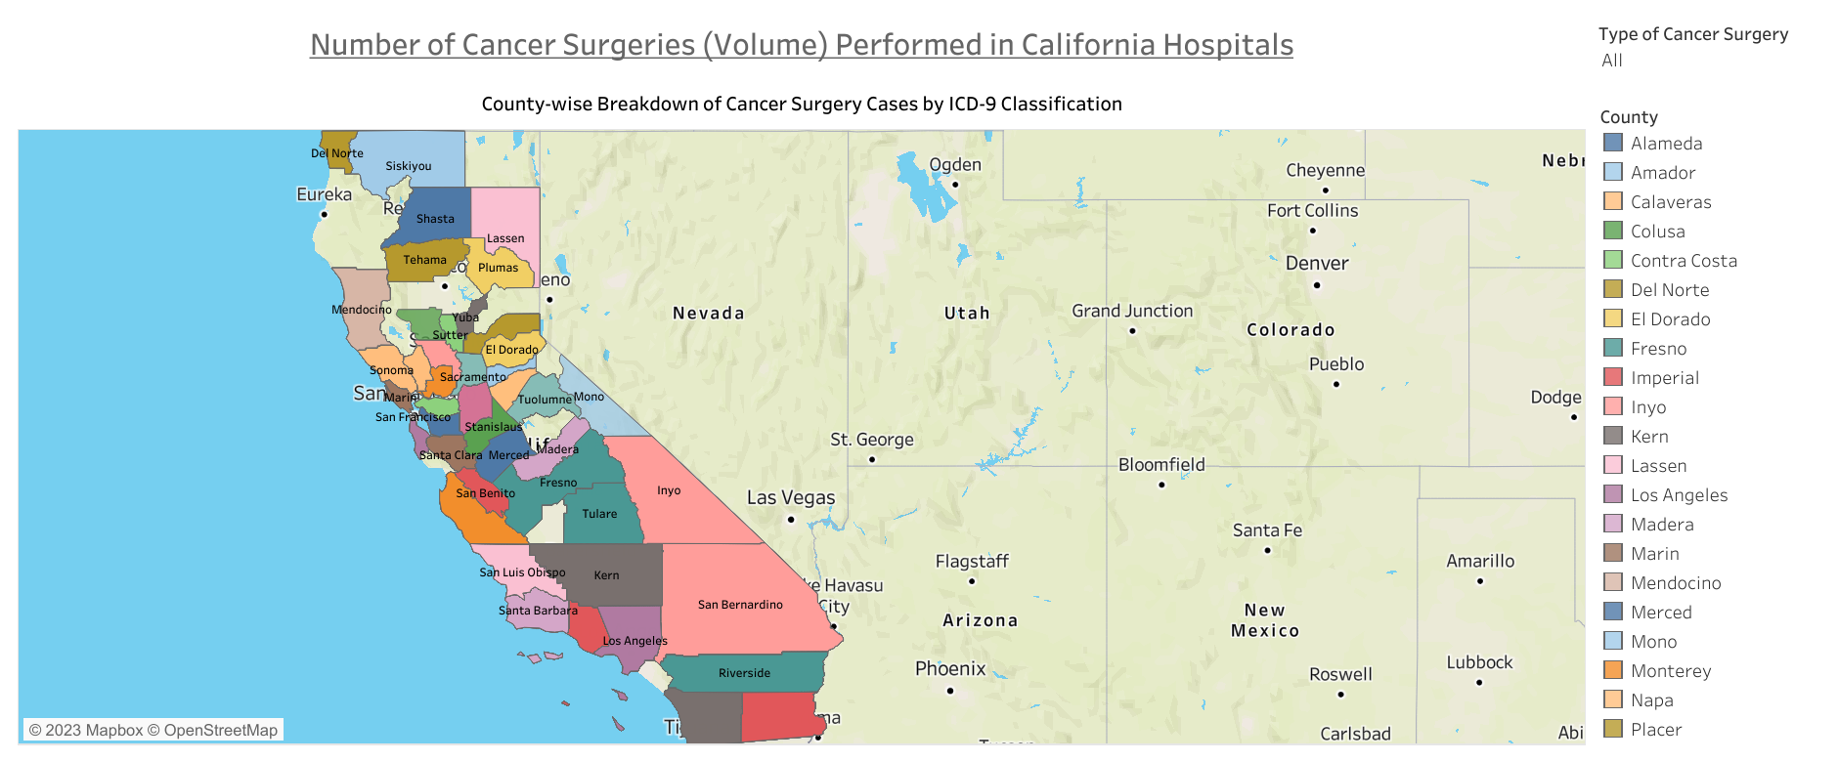
An Analysis of California Hospitals: Cancer Surgery Volume, Hospital Characteristics, and Patients Leaving Against Medical Advice (AMA) in Fiscal Year 2019-20

Slide 19
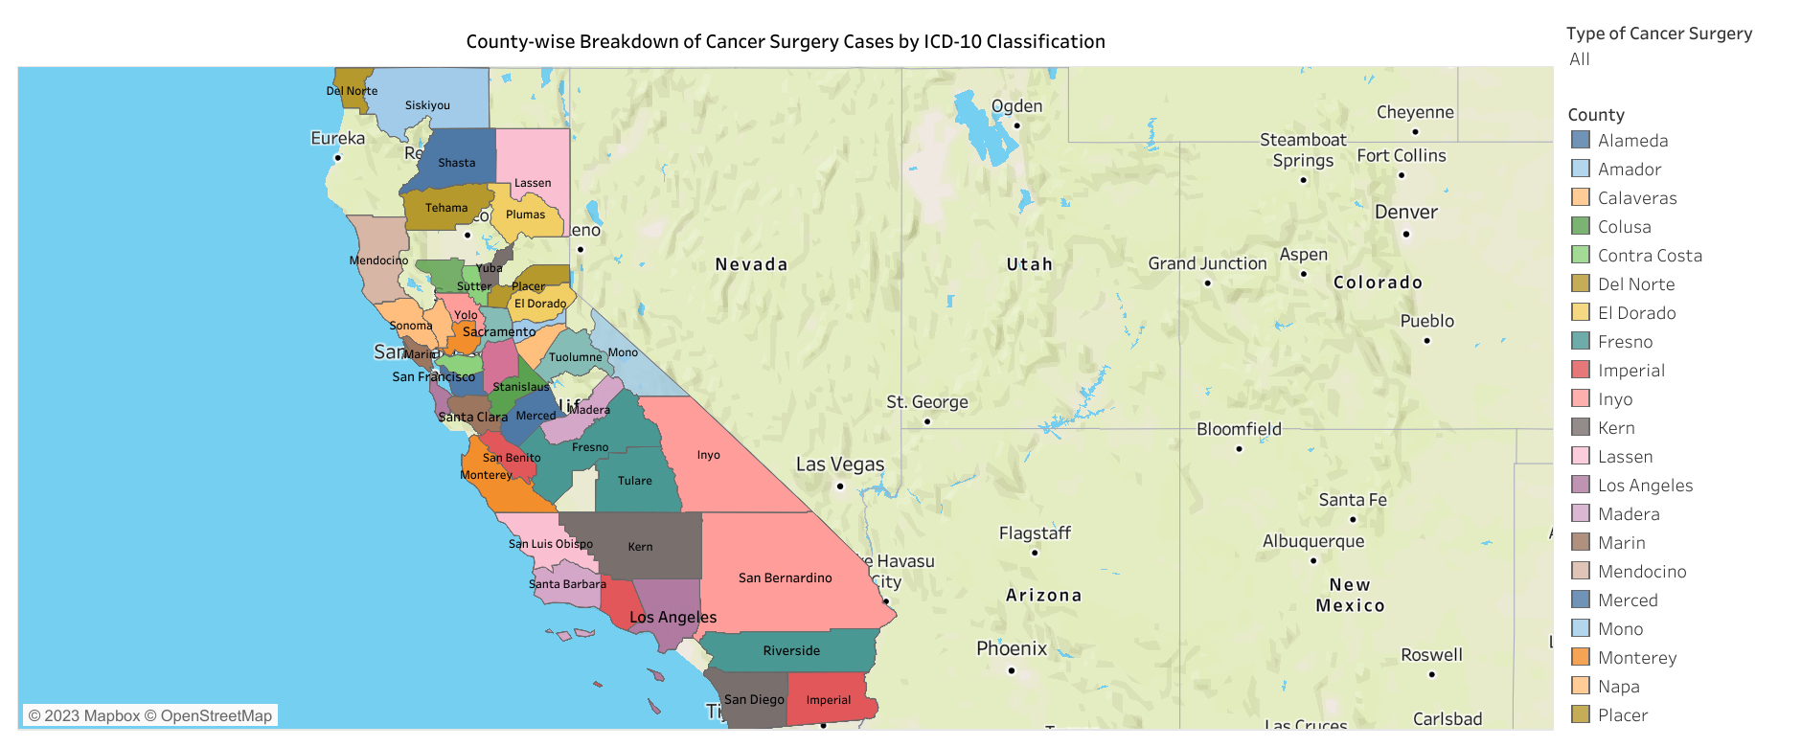

Slide 20
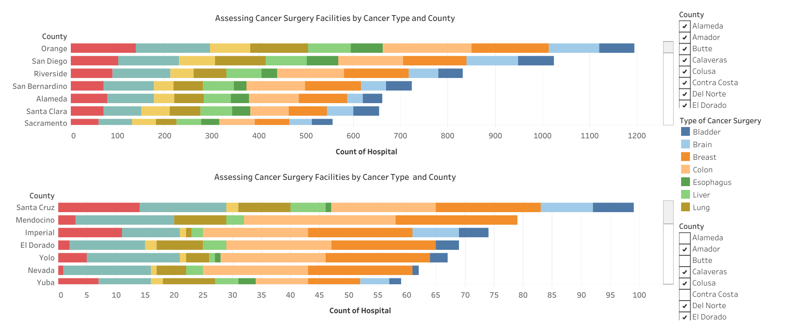

Slide 21
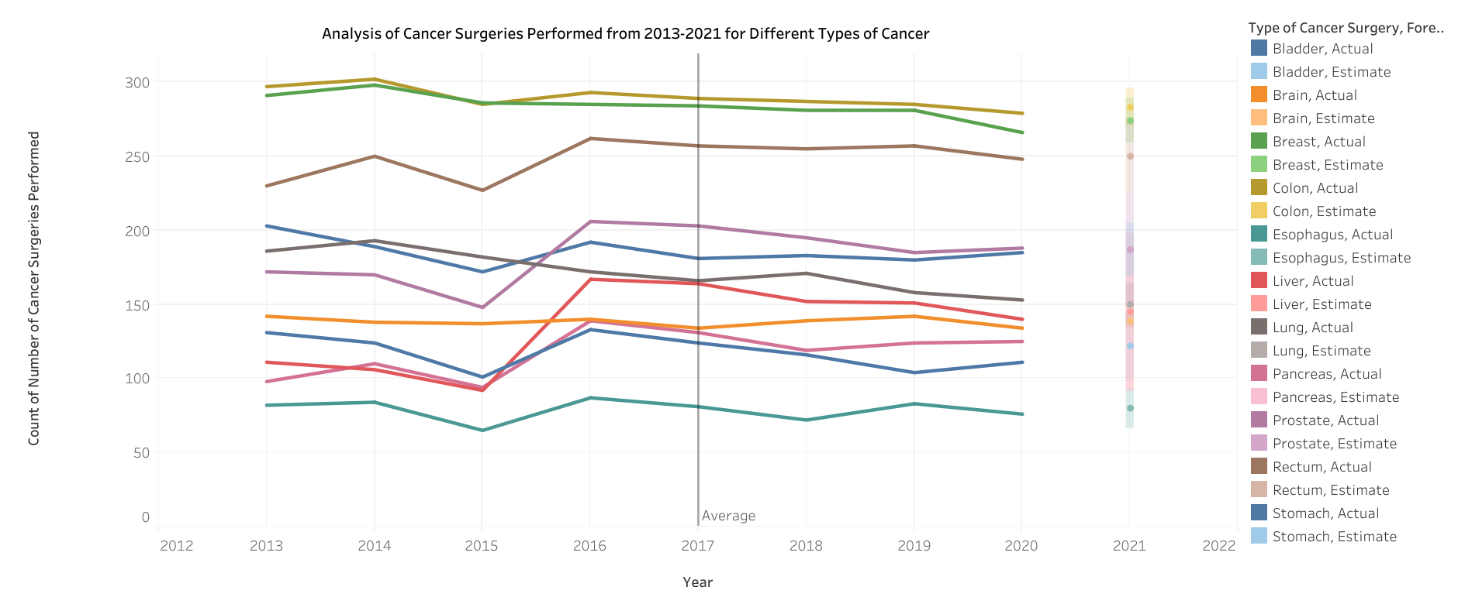

Slide 22
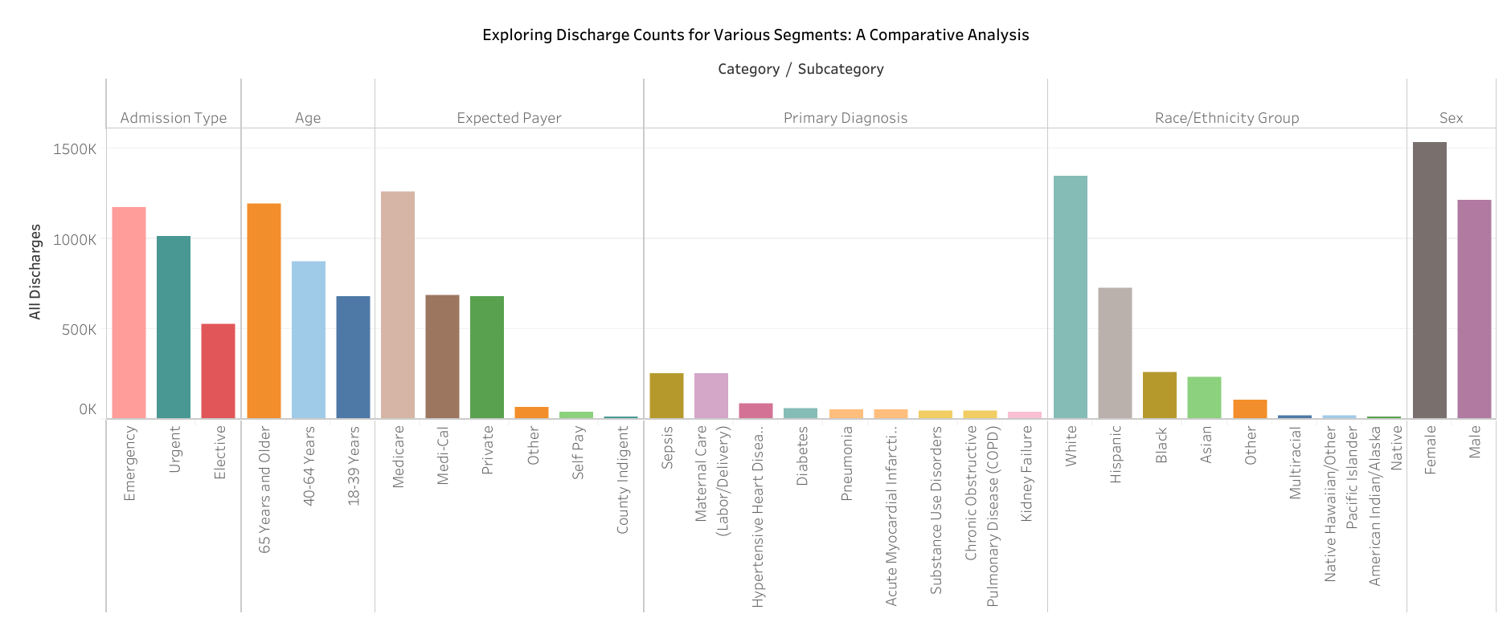

Slide 23
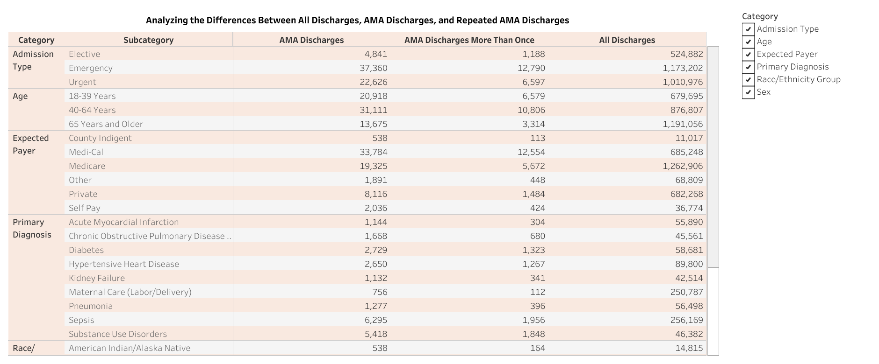

Slide 24
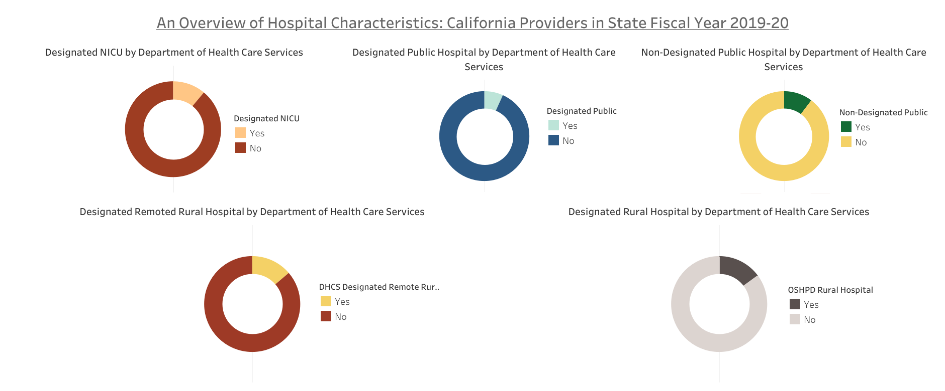

Slide 25
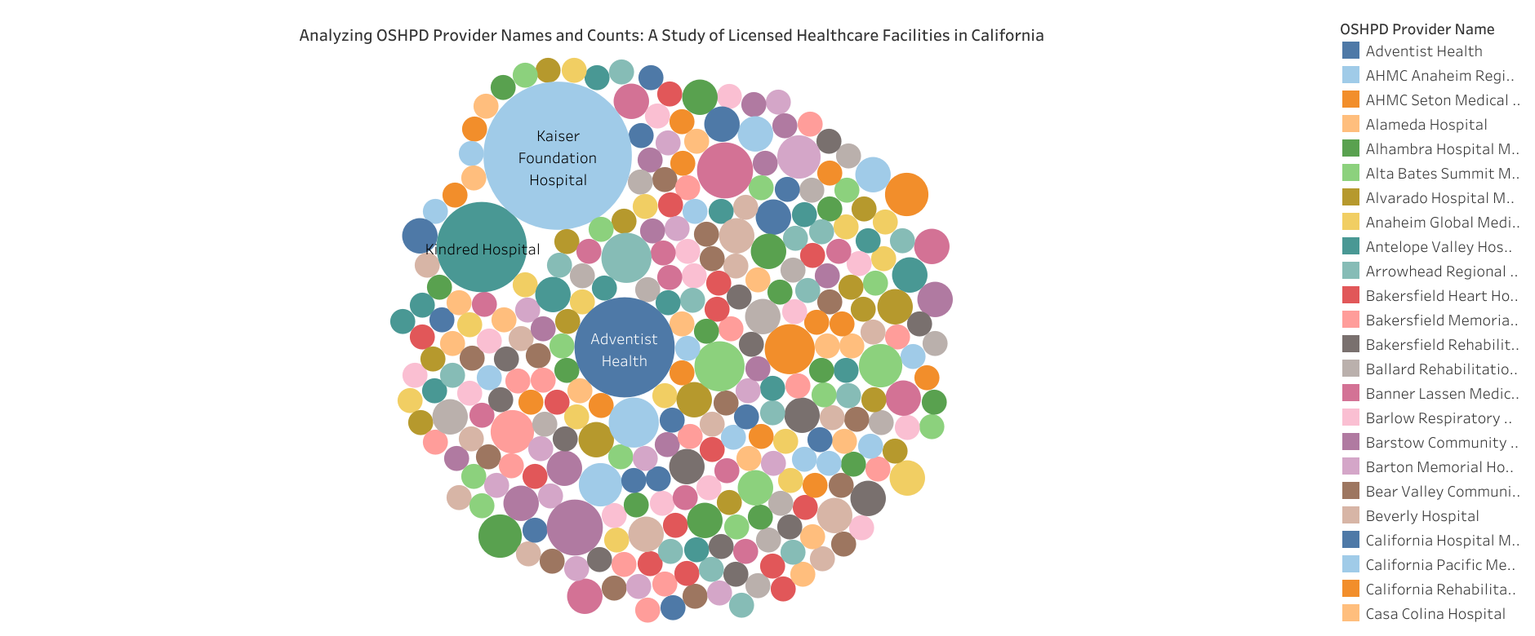

Slide 26
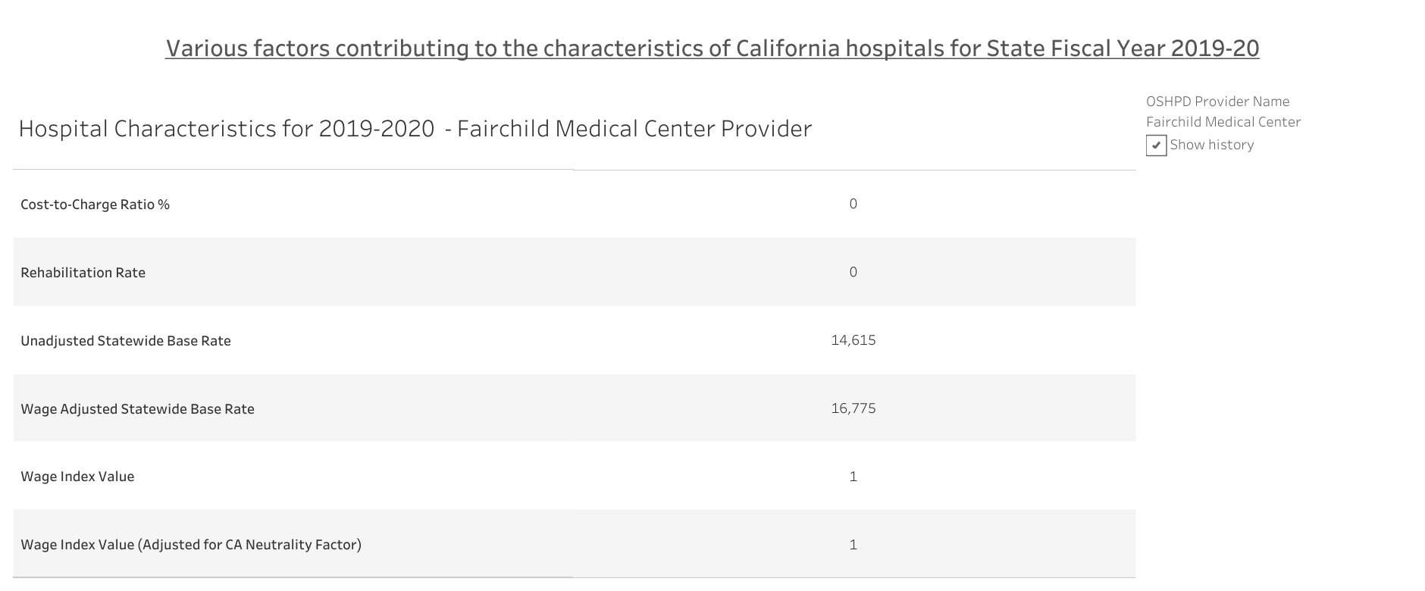

Slide 27
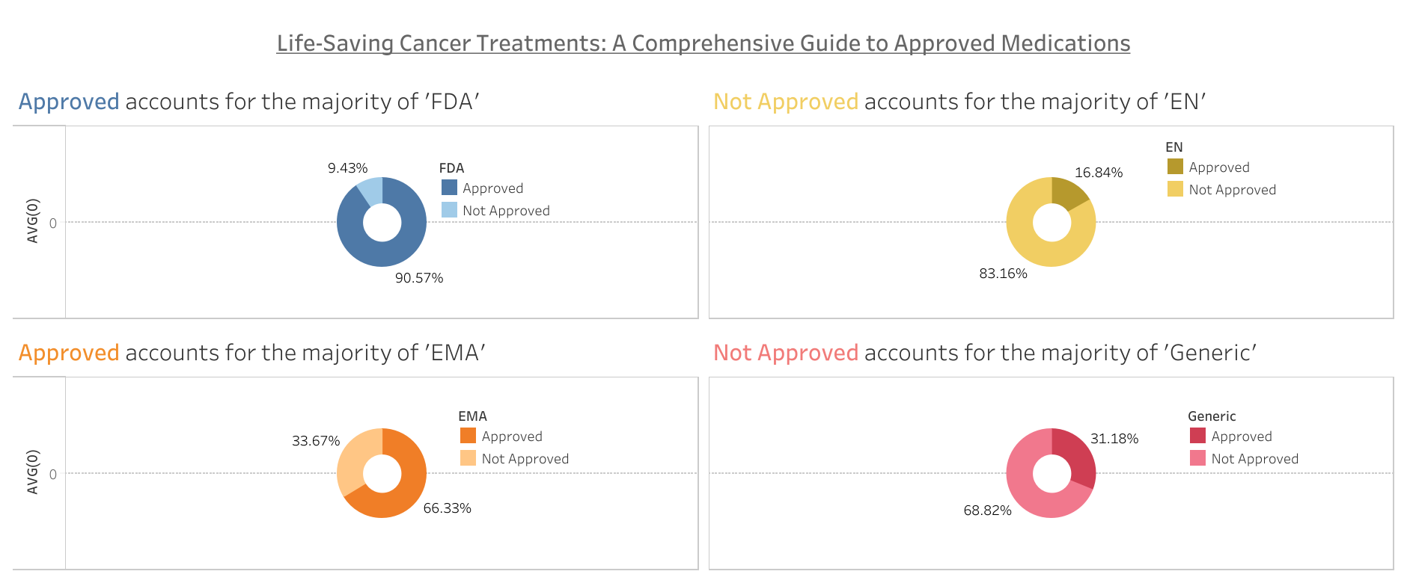
Life-Saving Cancer Treatments: A Comprehensive Guide to Approved Medications

Slide 28
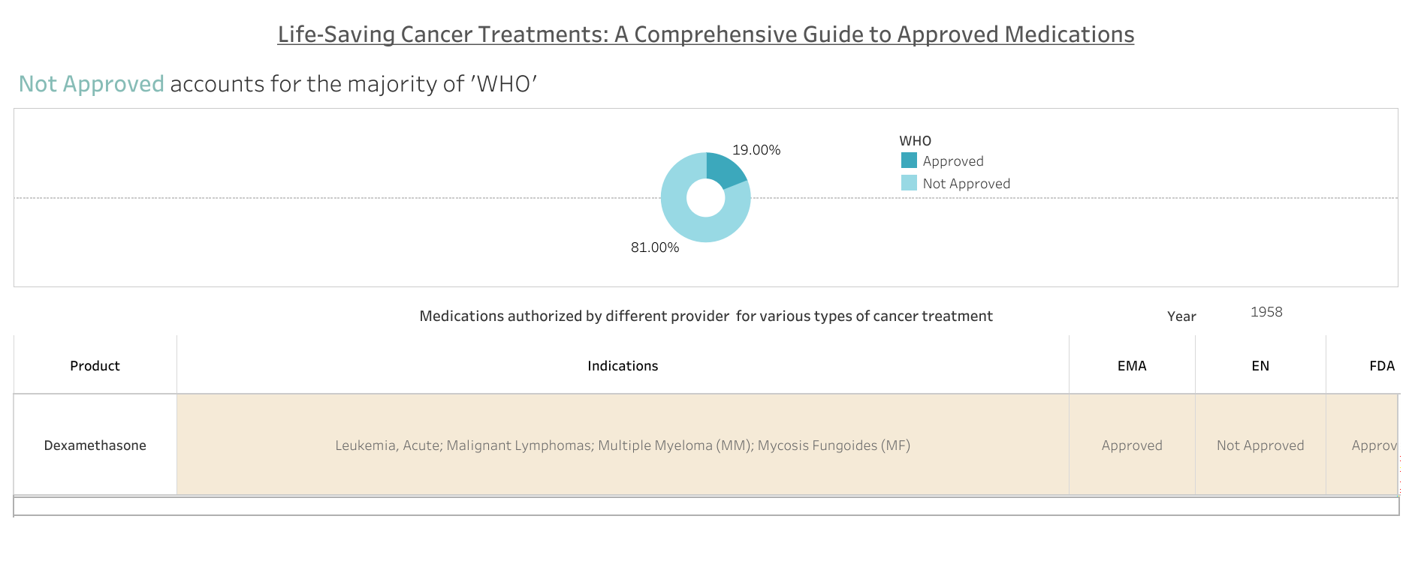

Slide 29
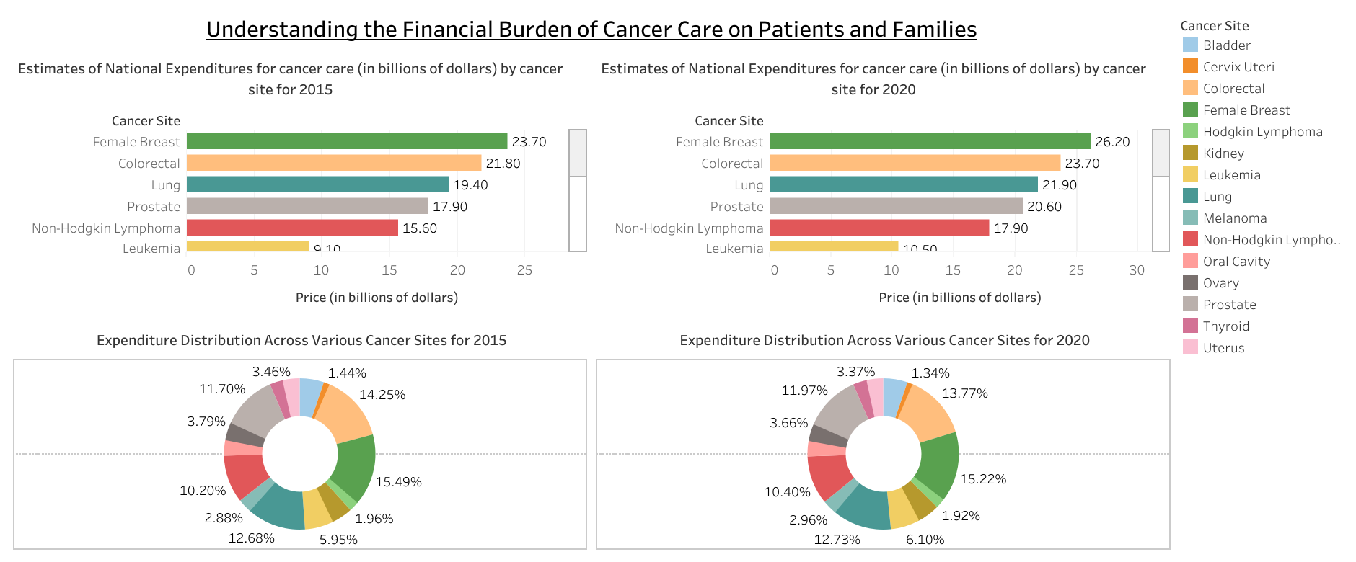
Understanding the Financial Burden of Cancer Care on Patients and Families

Slide 30
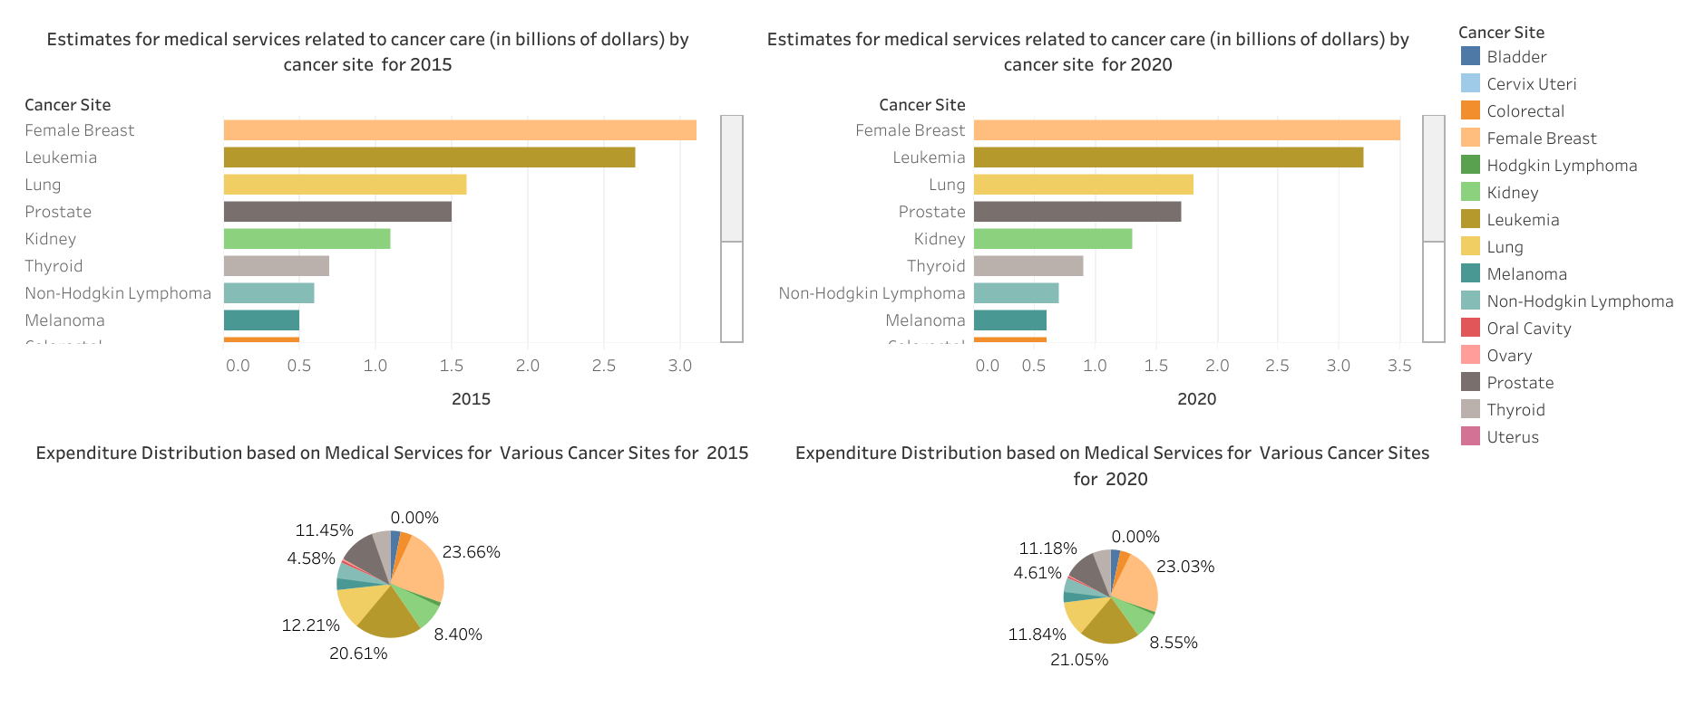

Slide 31
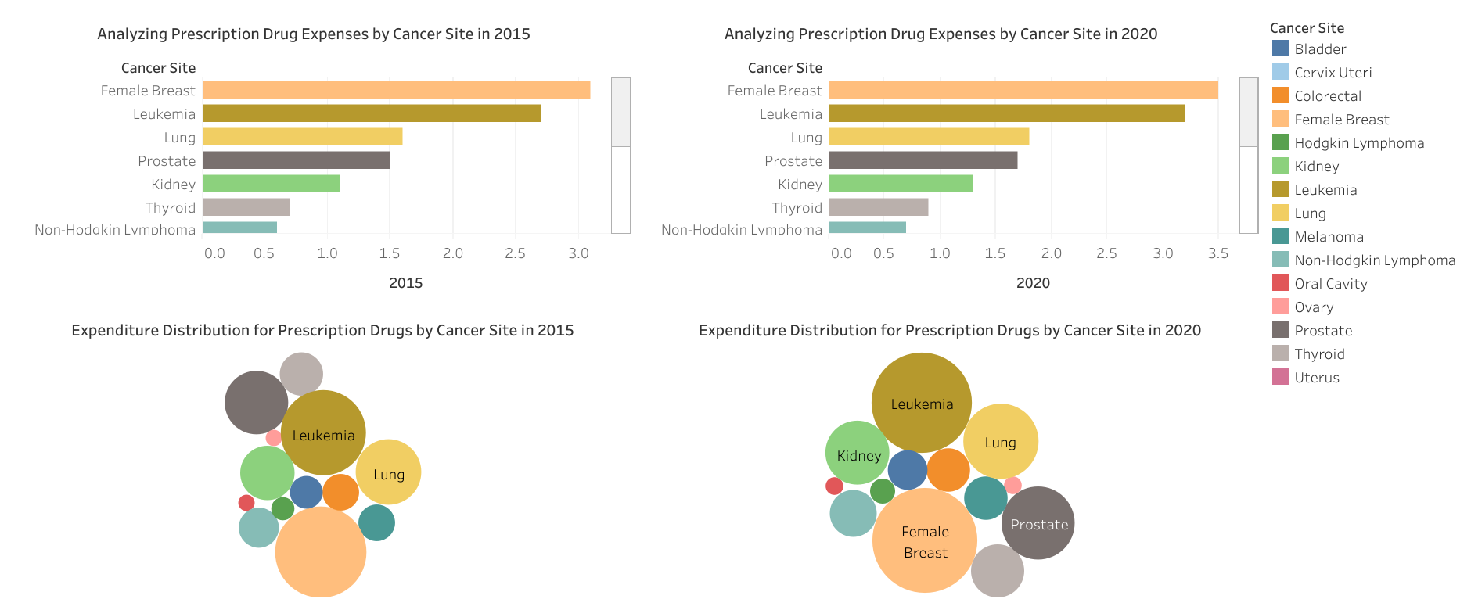

Slide 32
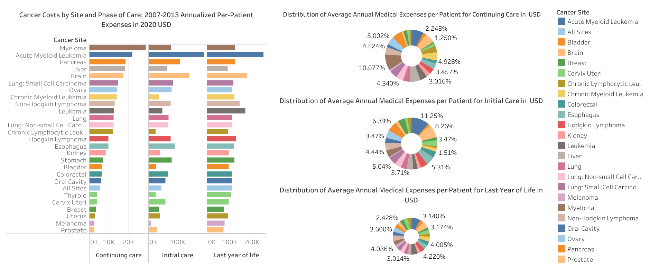

Slide 33
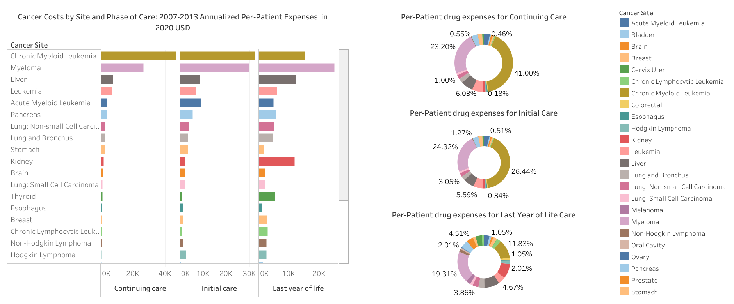

Slide 34
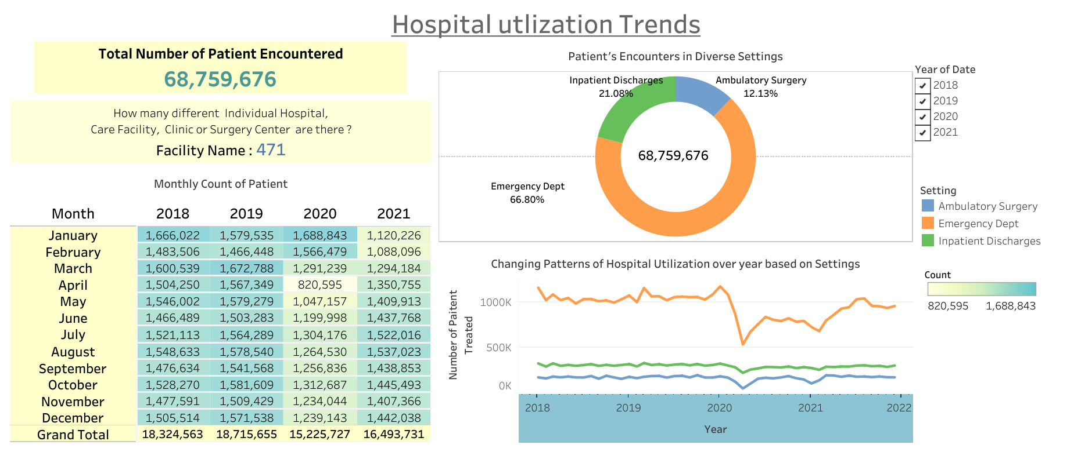
Effects of COVID-19 on Hospital Utilization Trends: Hospital Utilization Trends

Slide 35
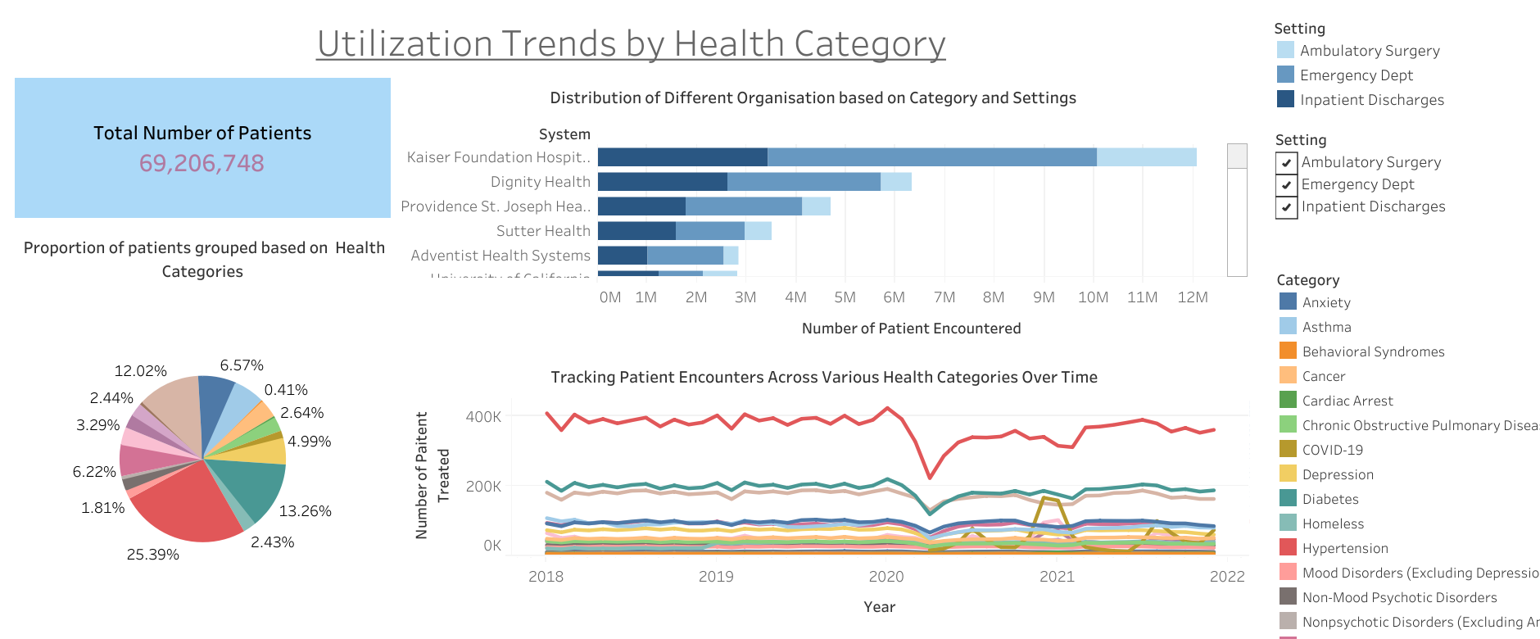

Slide 36
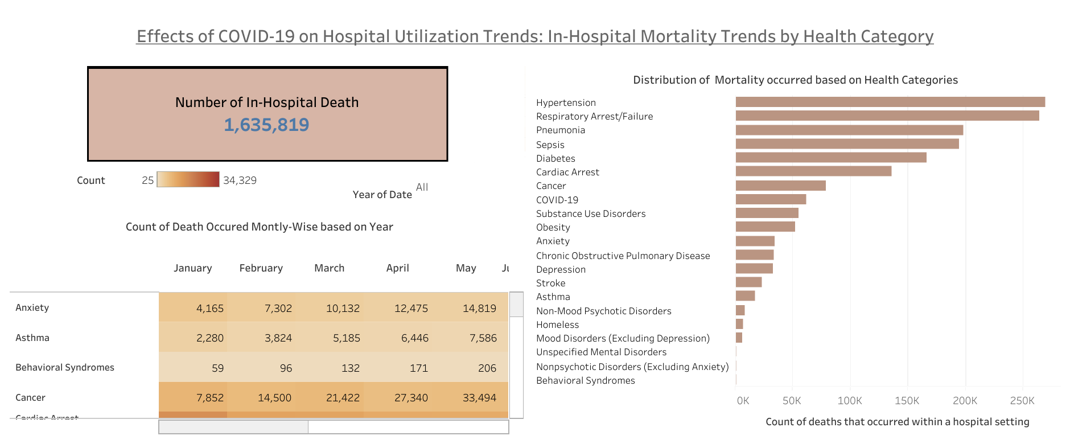

Slide 37
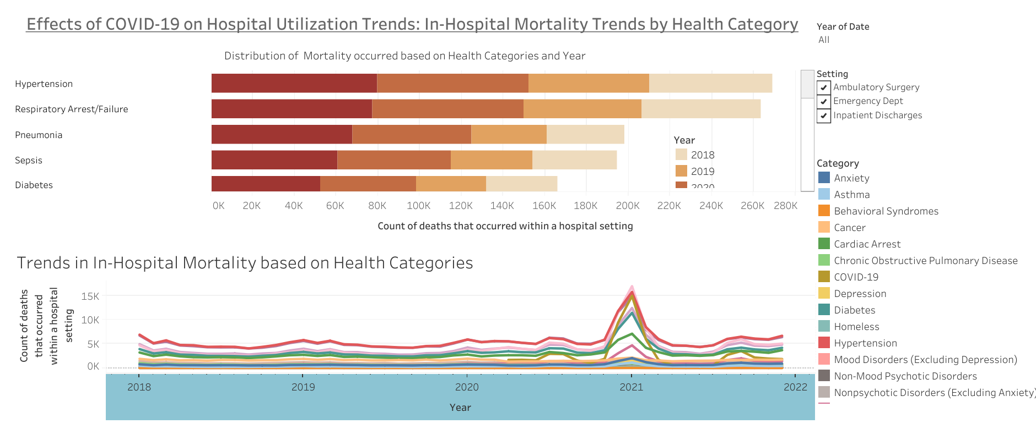

Slide 38
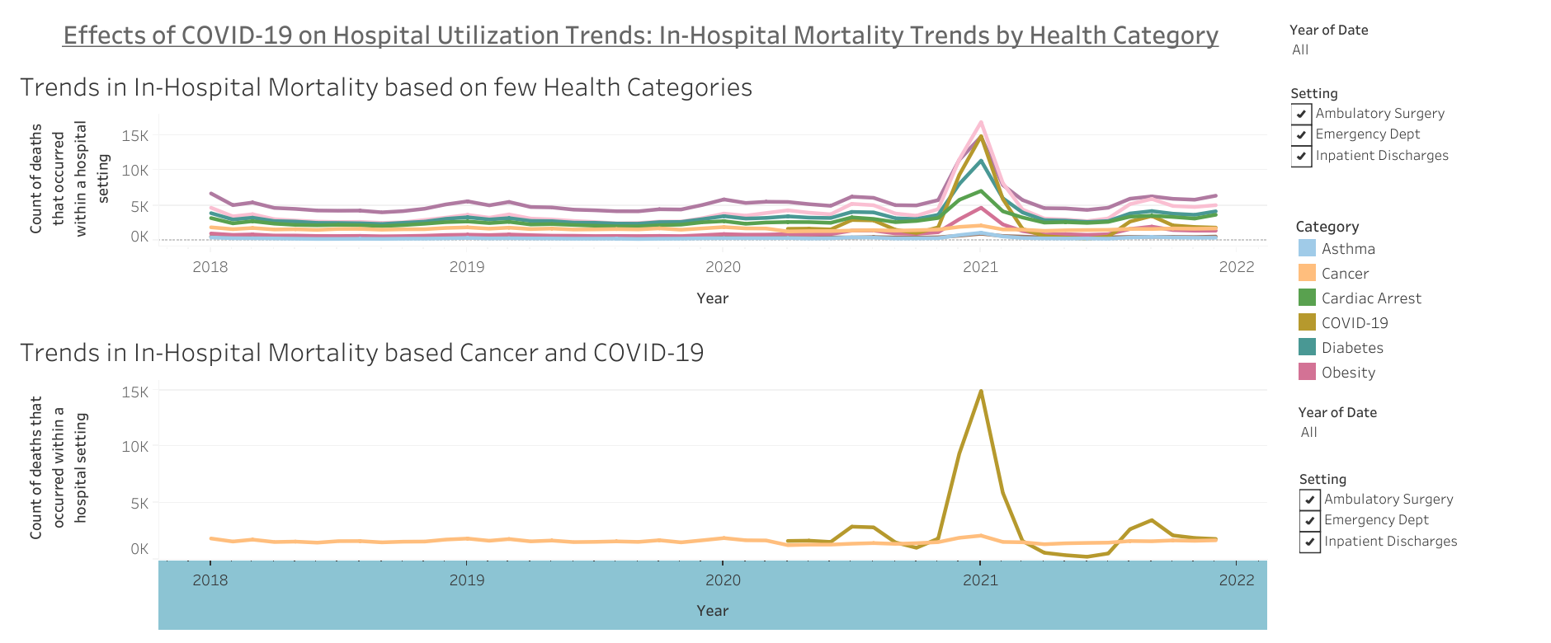

Slide 39
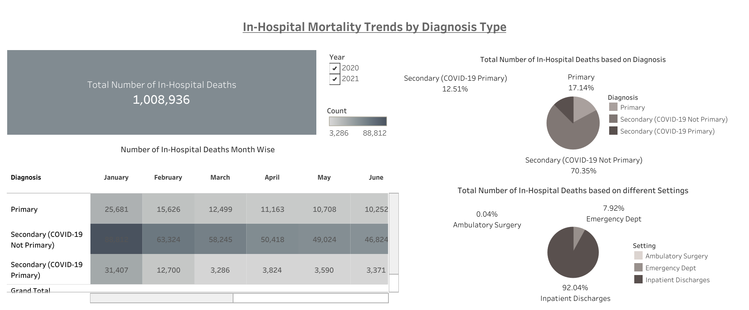

Slide 40
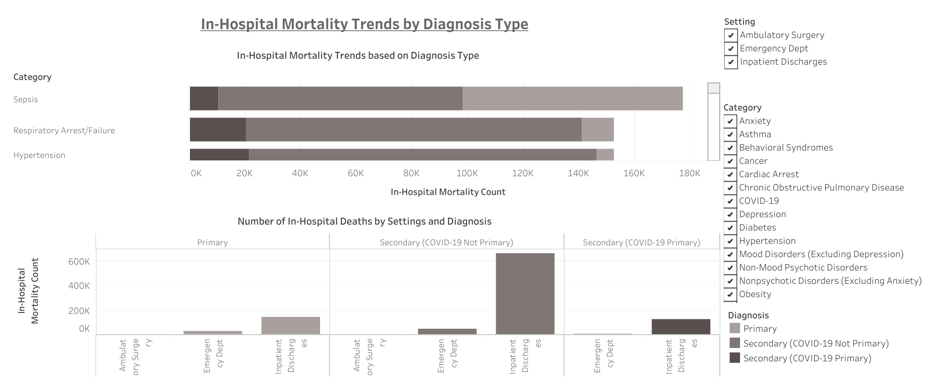

Slide 41
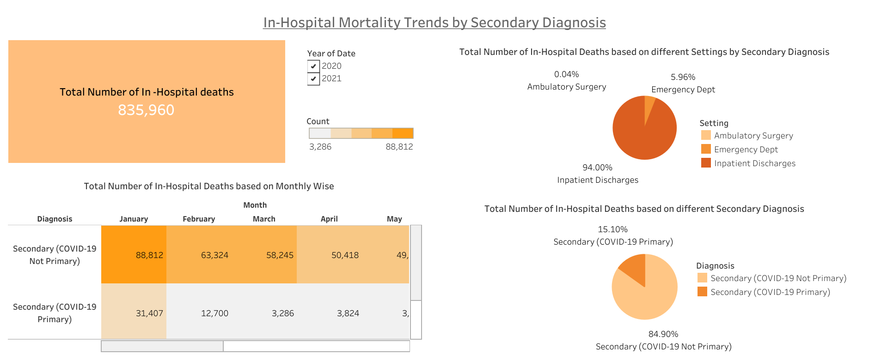

Slide 42
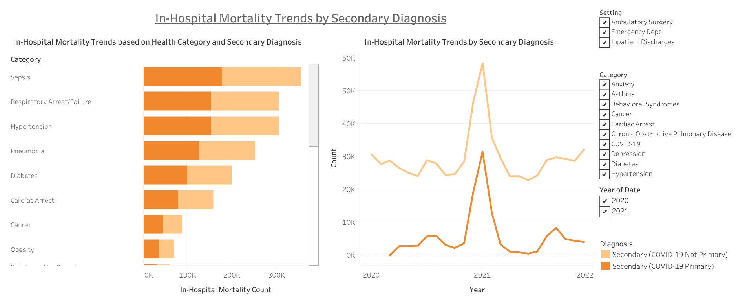

Slide 43
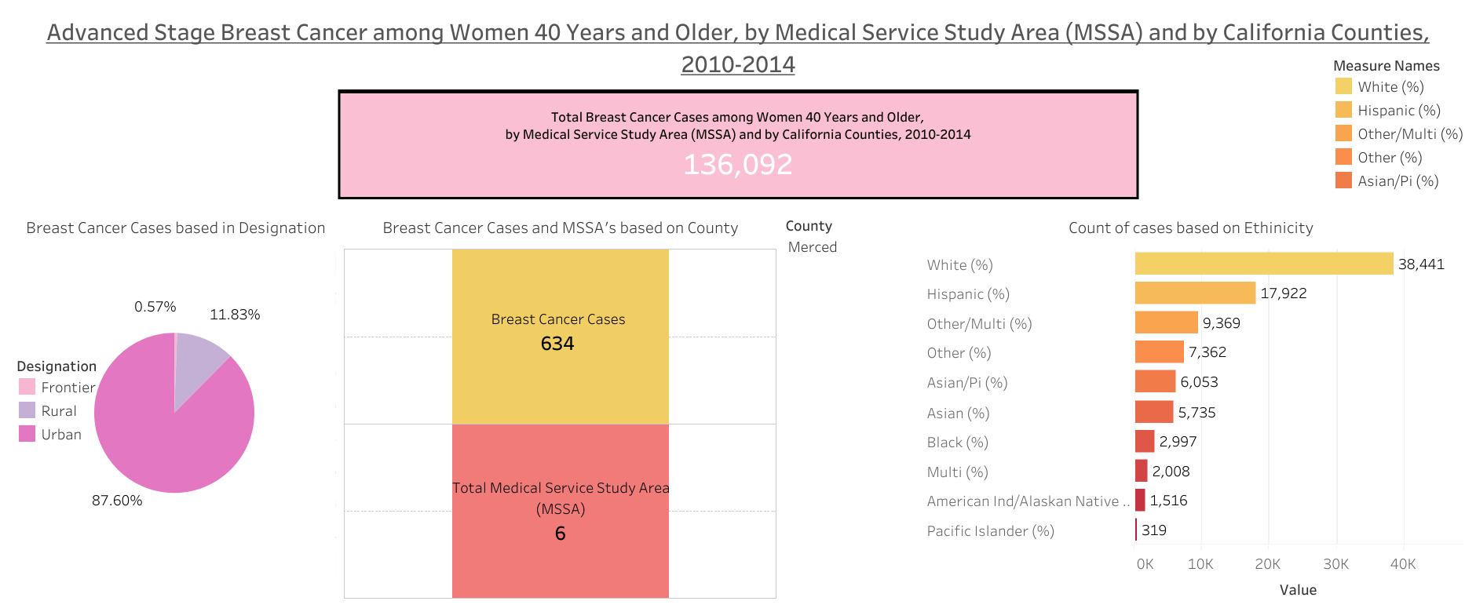
Geographic Analysis of Advanced Stage Breast Cancer in Women 40 Years and Older: A Study of Medical Service Study Areas and California Counties from 2010-2014

Slide 44
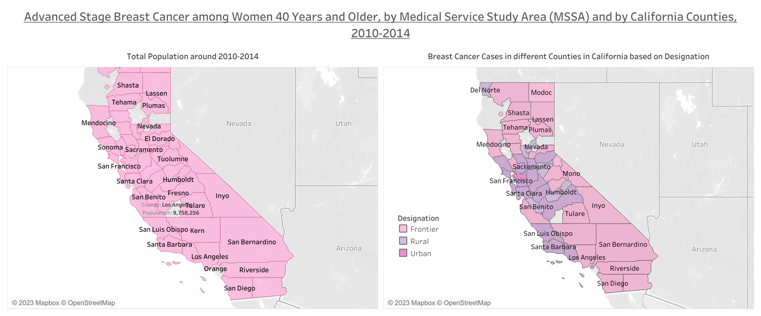

Slide 45
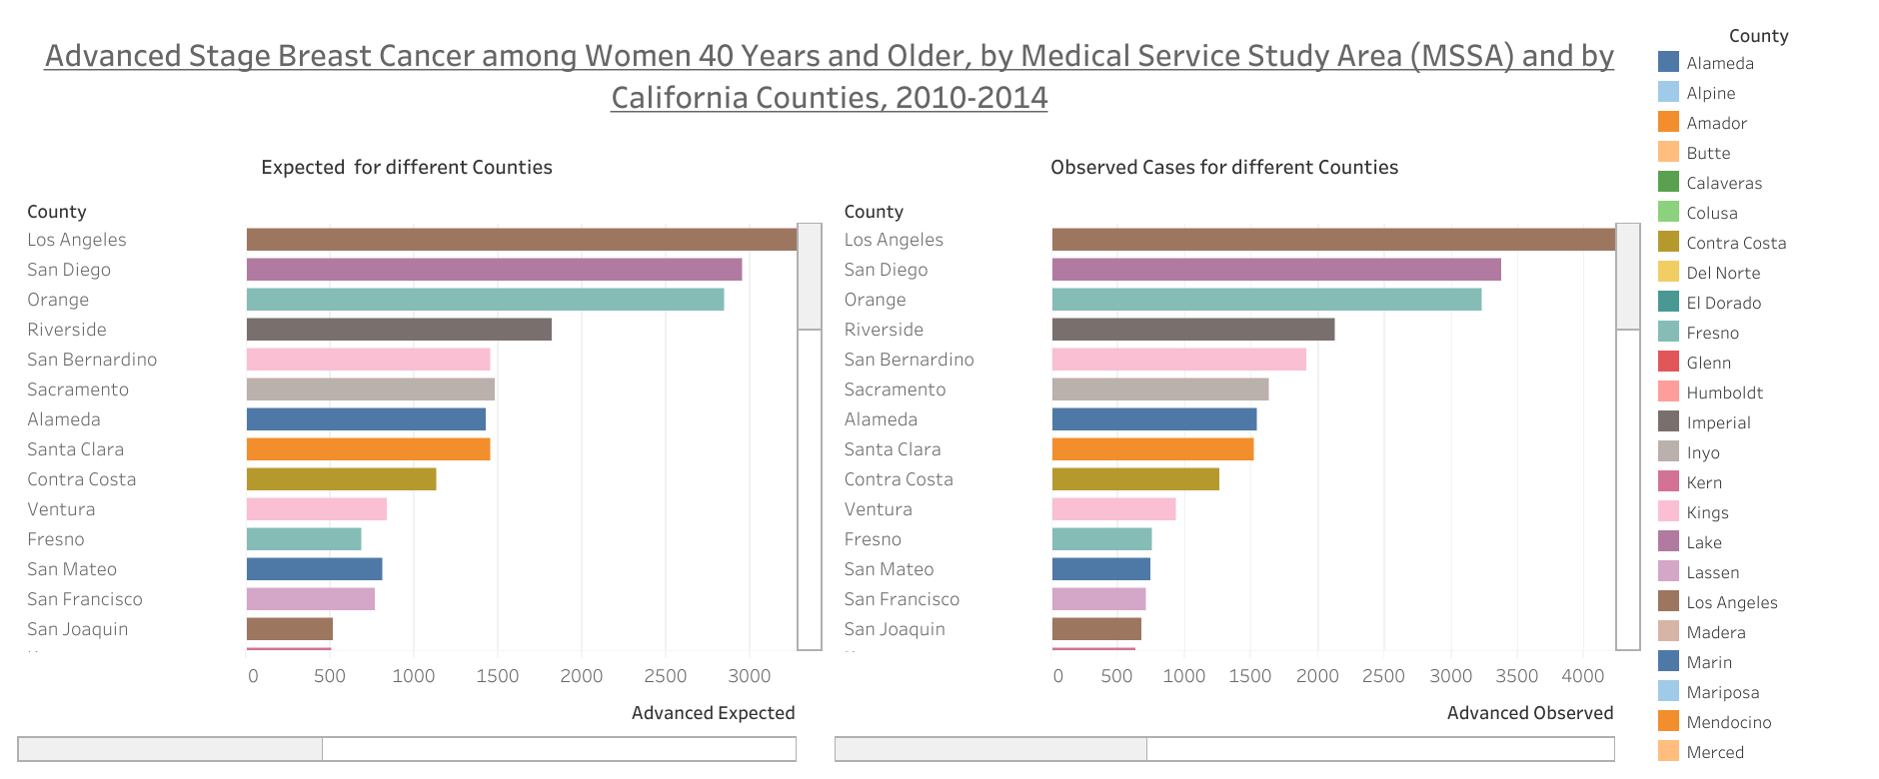

Slide 46
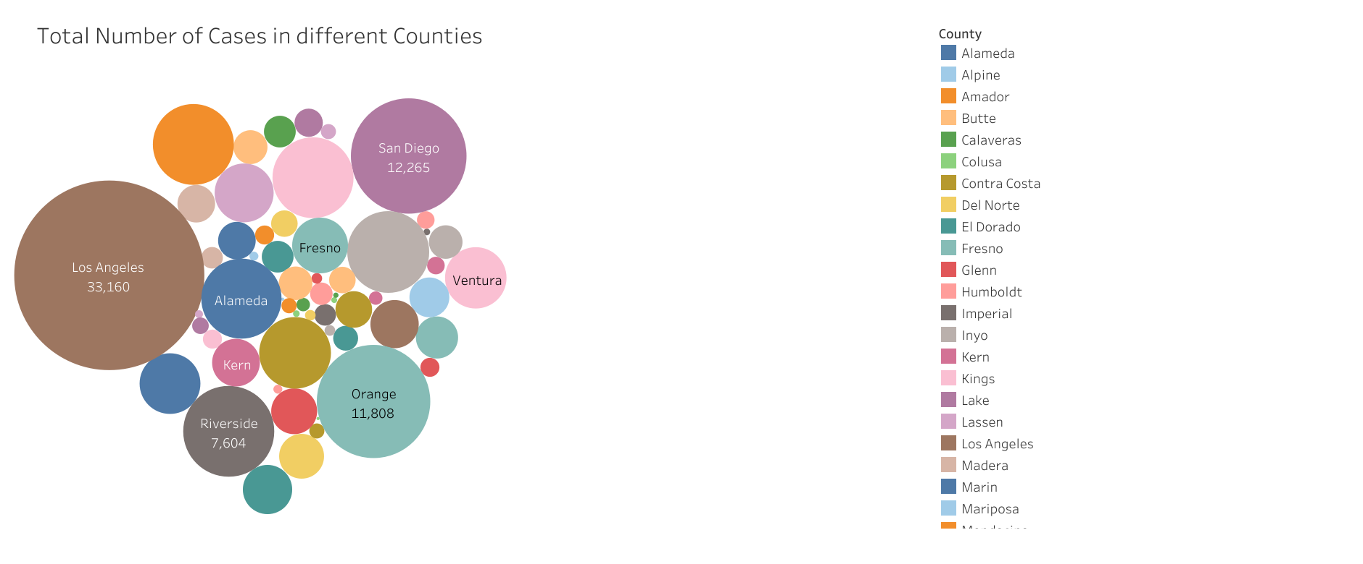

Slide 47
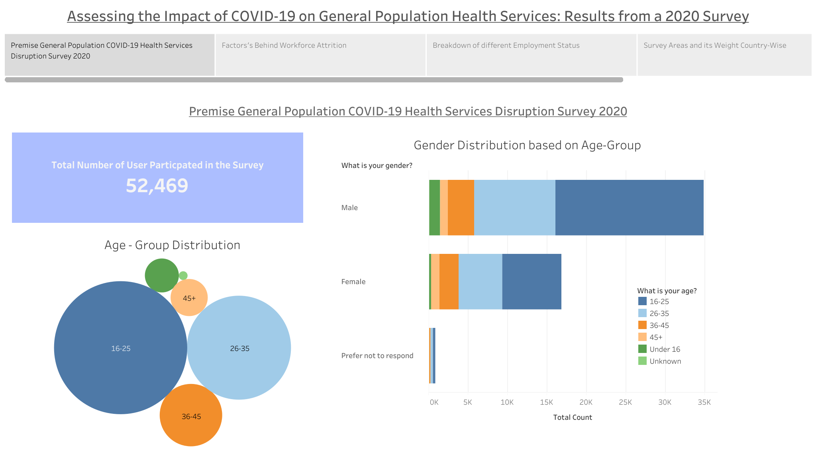
Assessing the Impact of COVID-19 on General Population Health Services: Results from a 2020 Survey

Slide 48
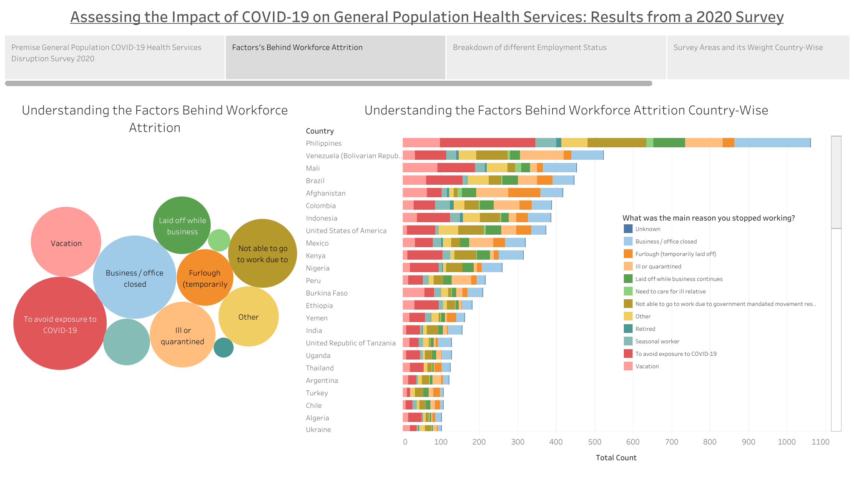

Slide 49
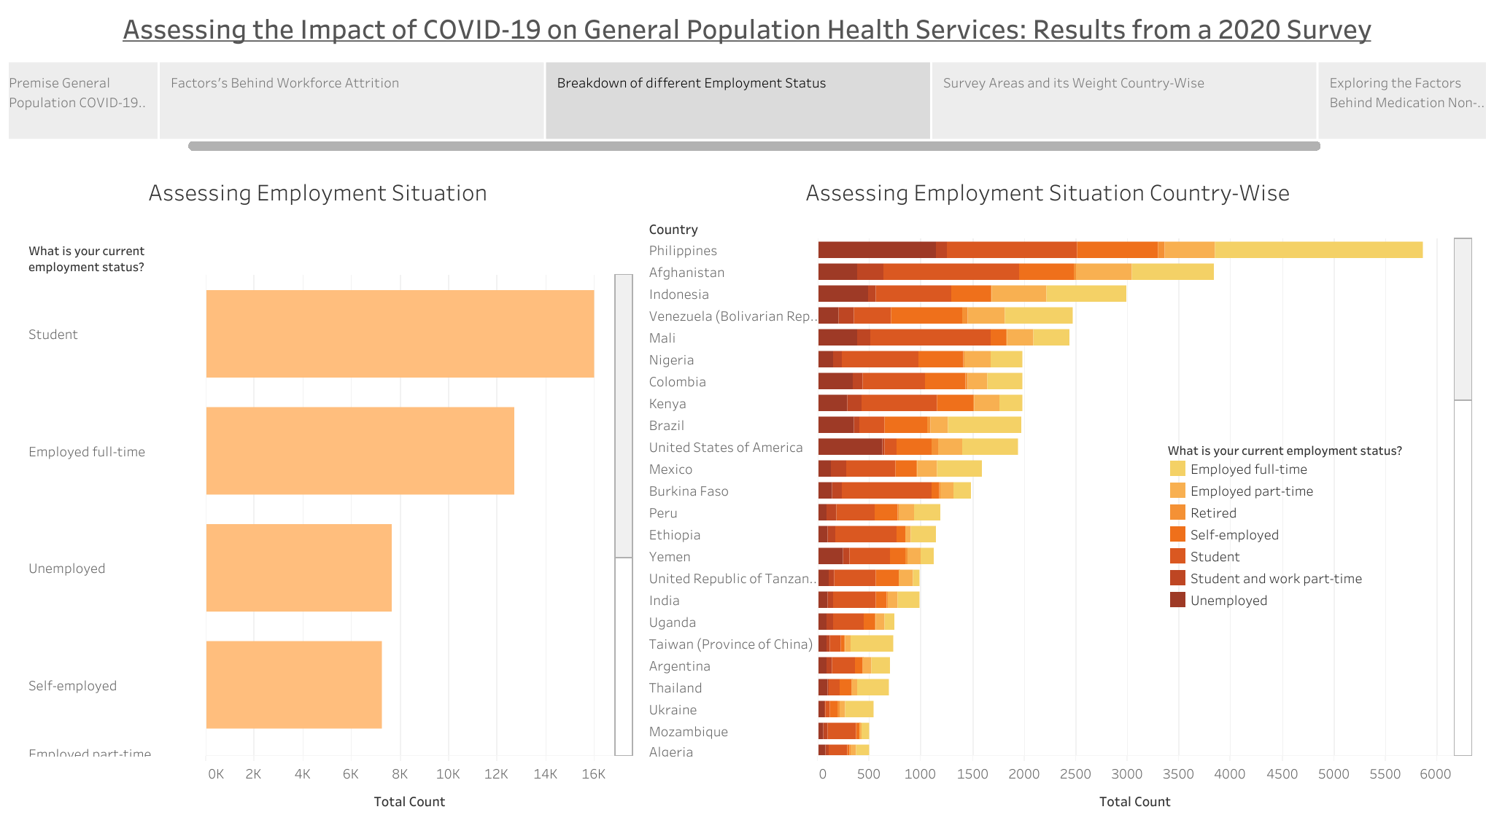

Slide 50
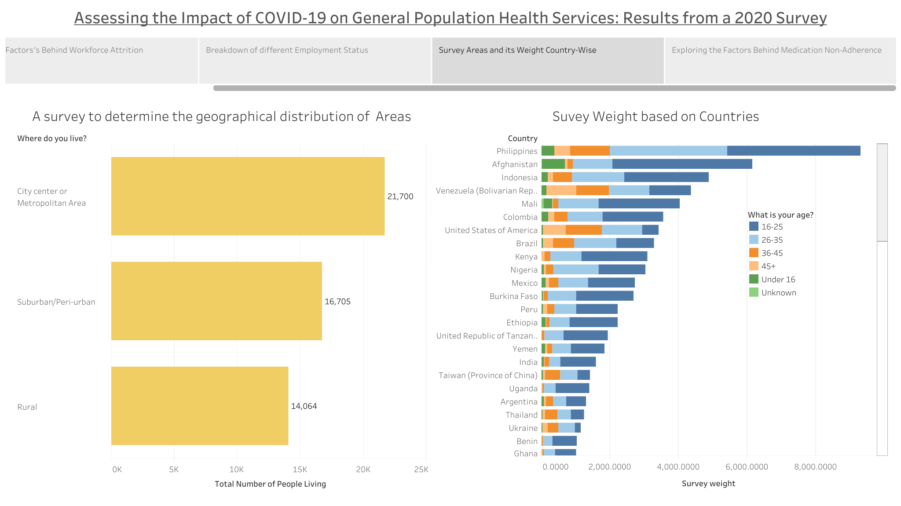

Slide 51
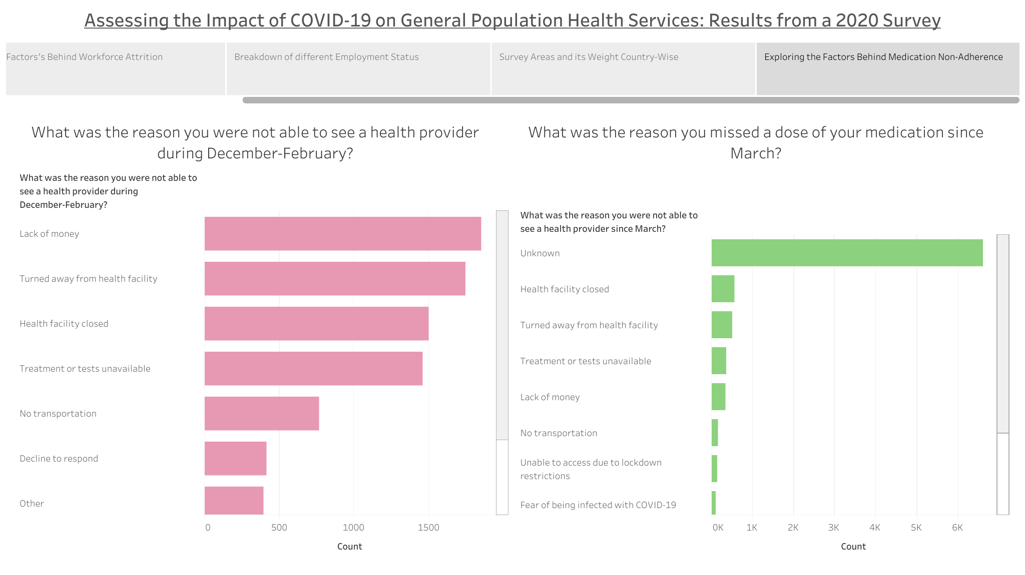

Slide 52
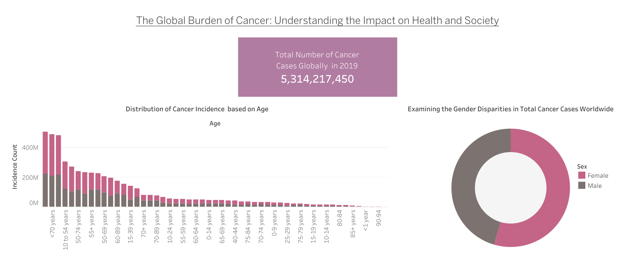
The Global Burden of Cancer: Understanding the Impact on Health and Society

Slide 53
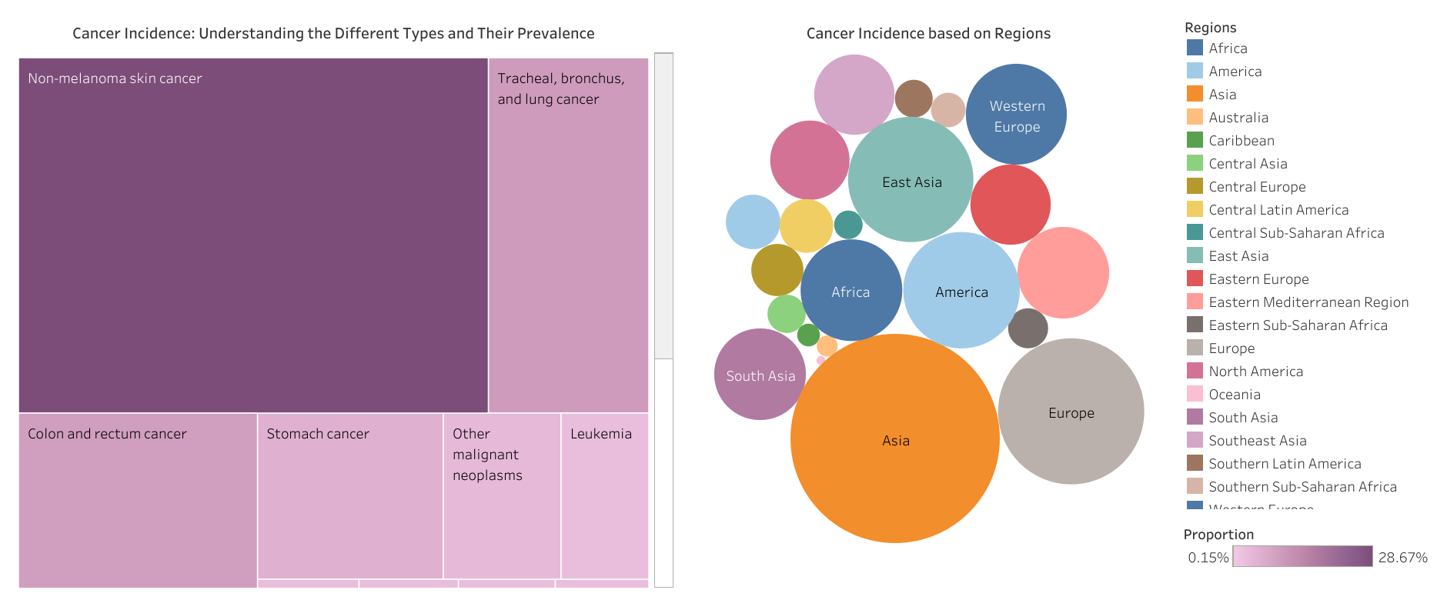

Slide 54
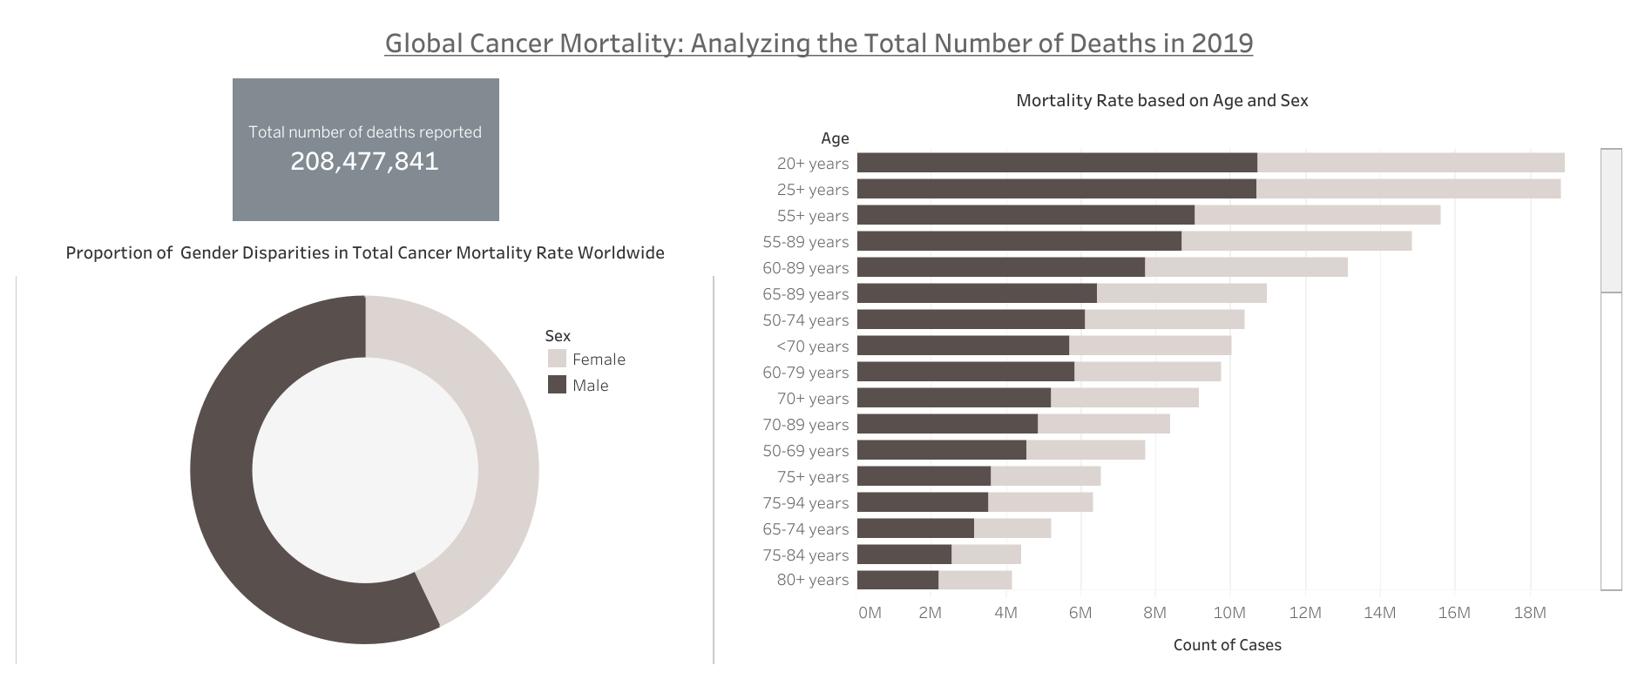

Slide 55
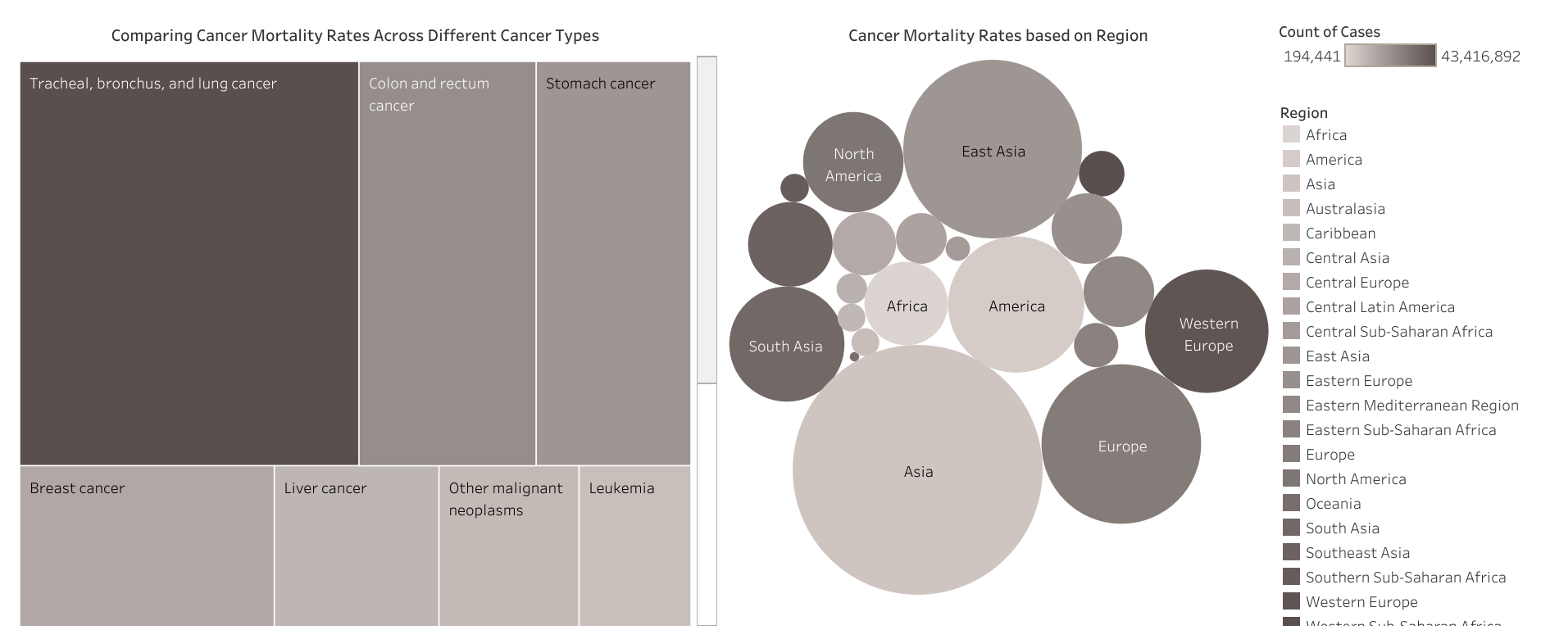

Slide 56
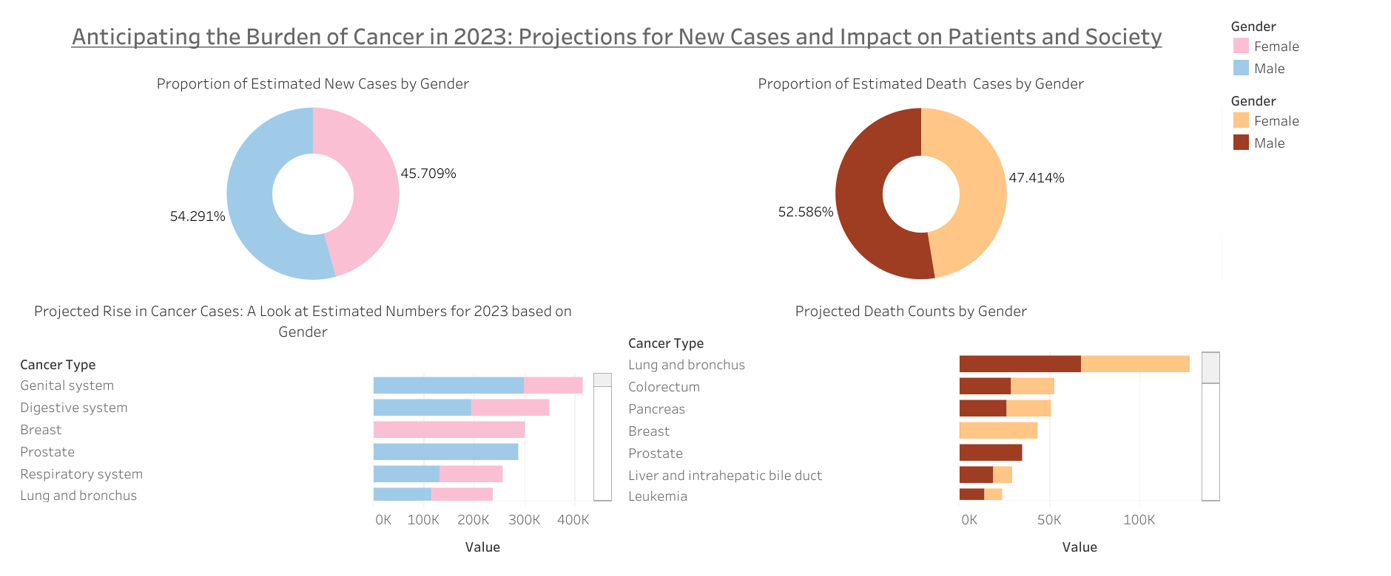
Mapping the Burden of Cancer: A State-by-State Analysis of Cancer Incidence and Mortality in the US

Slide 57
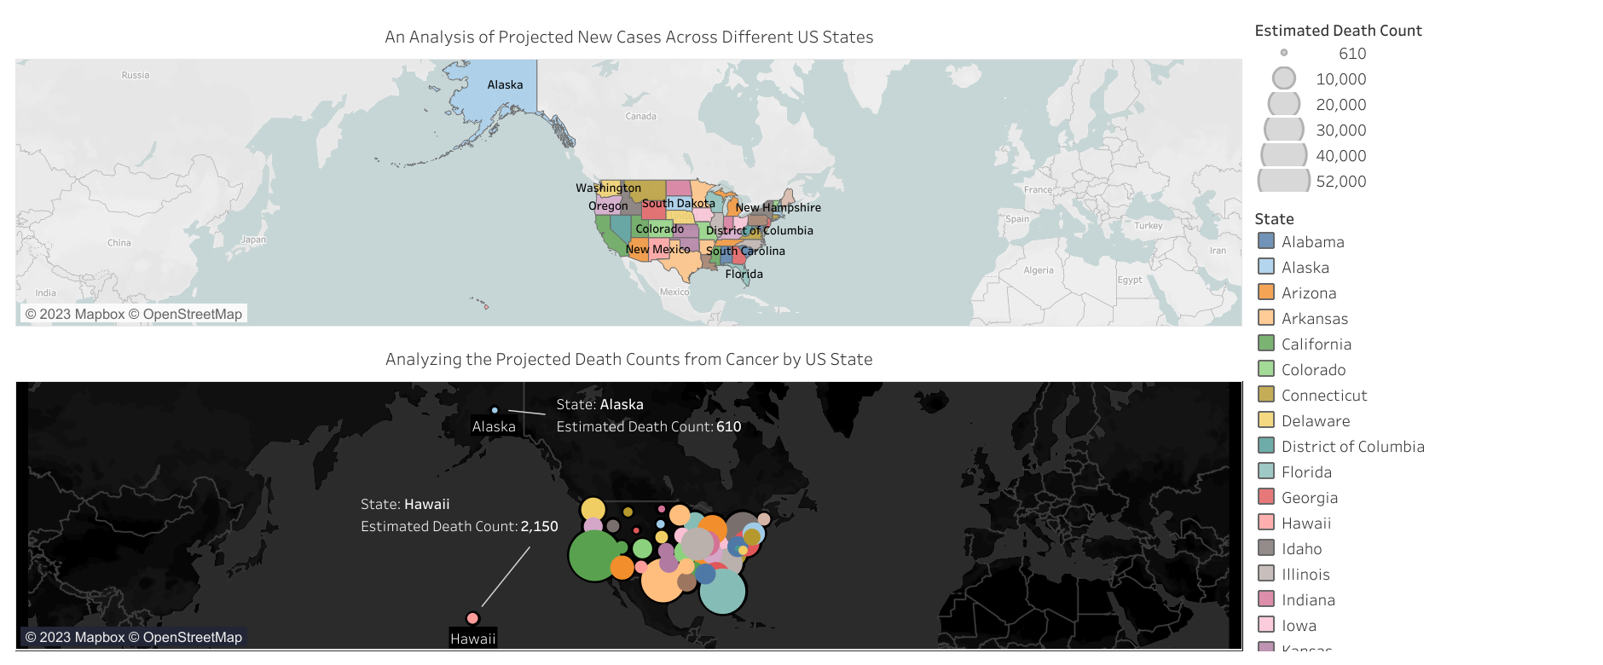

Slide 58
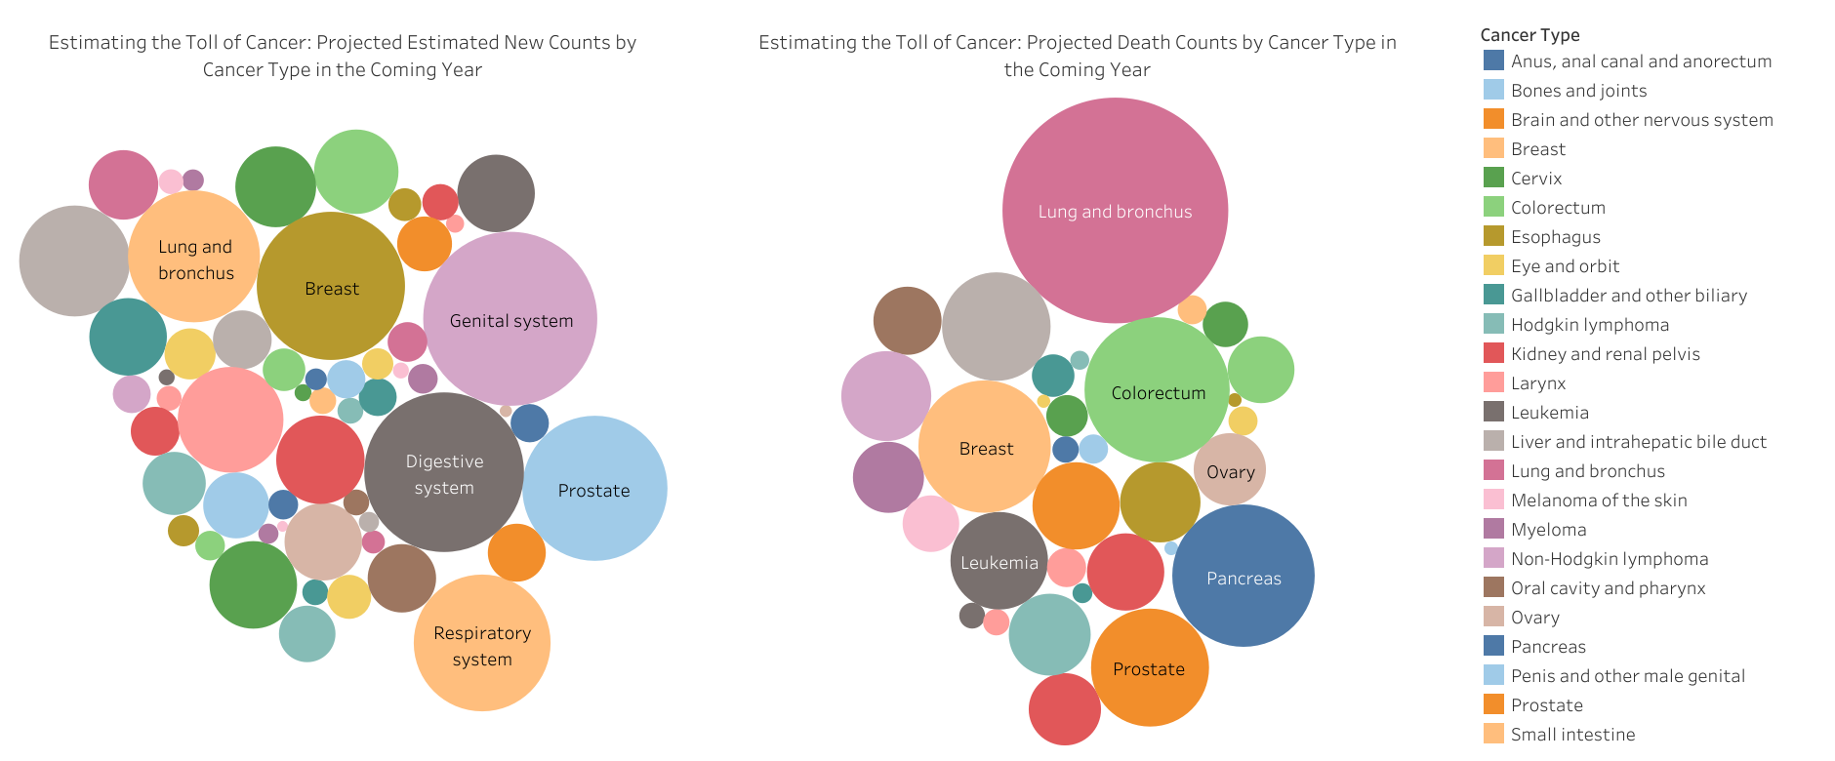

Slide 59
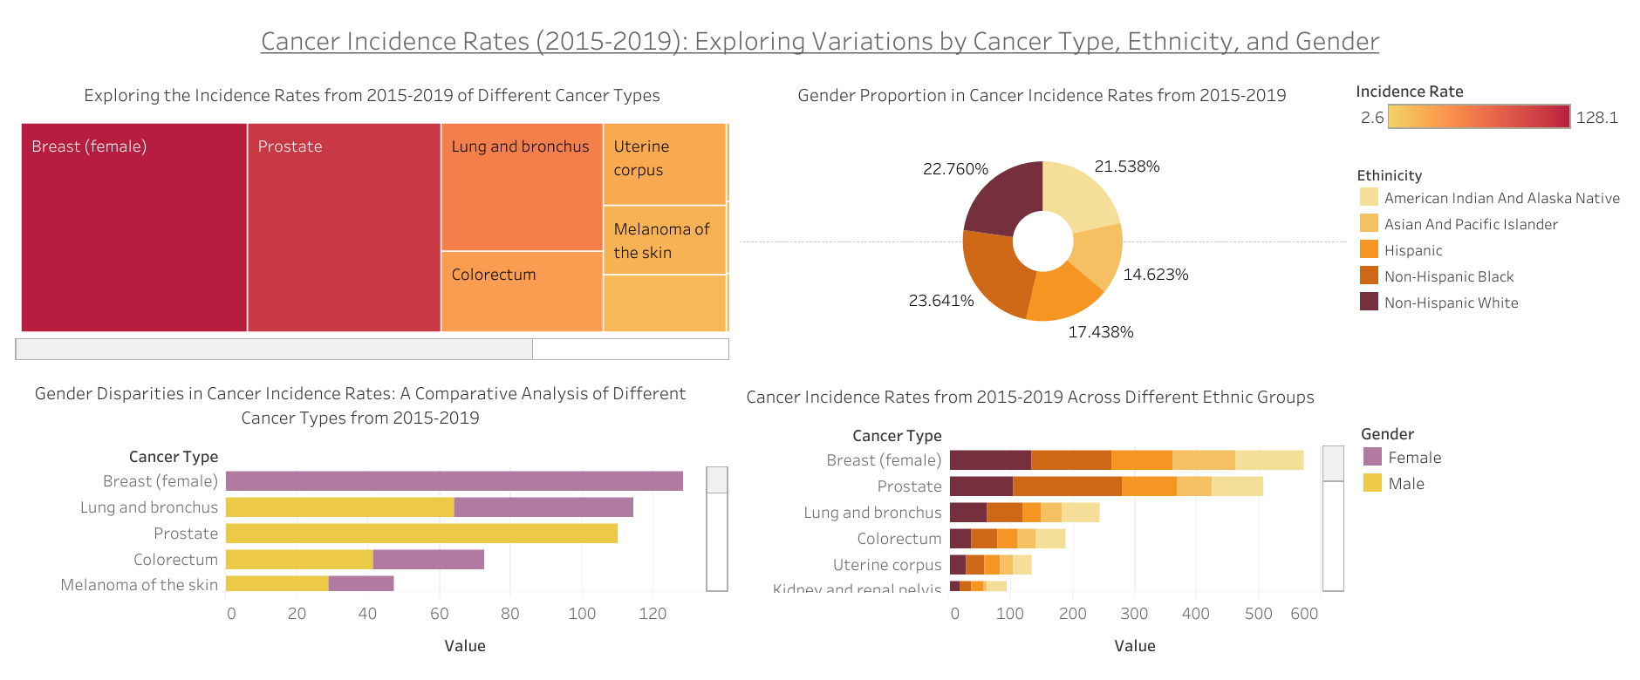

Slide 60
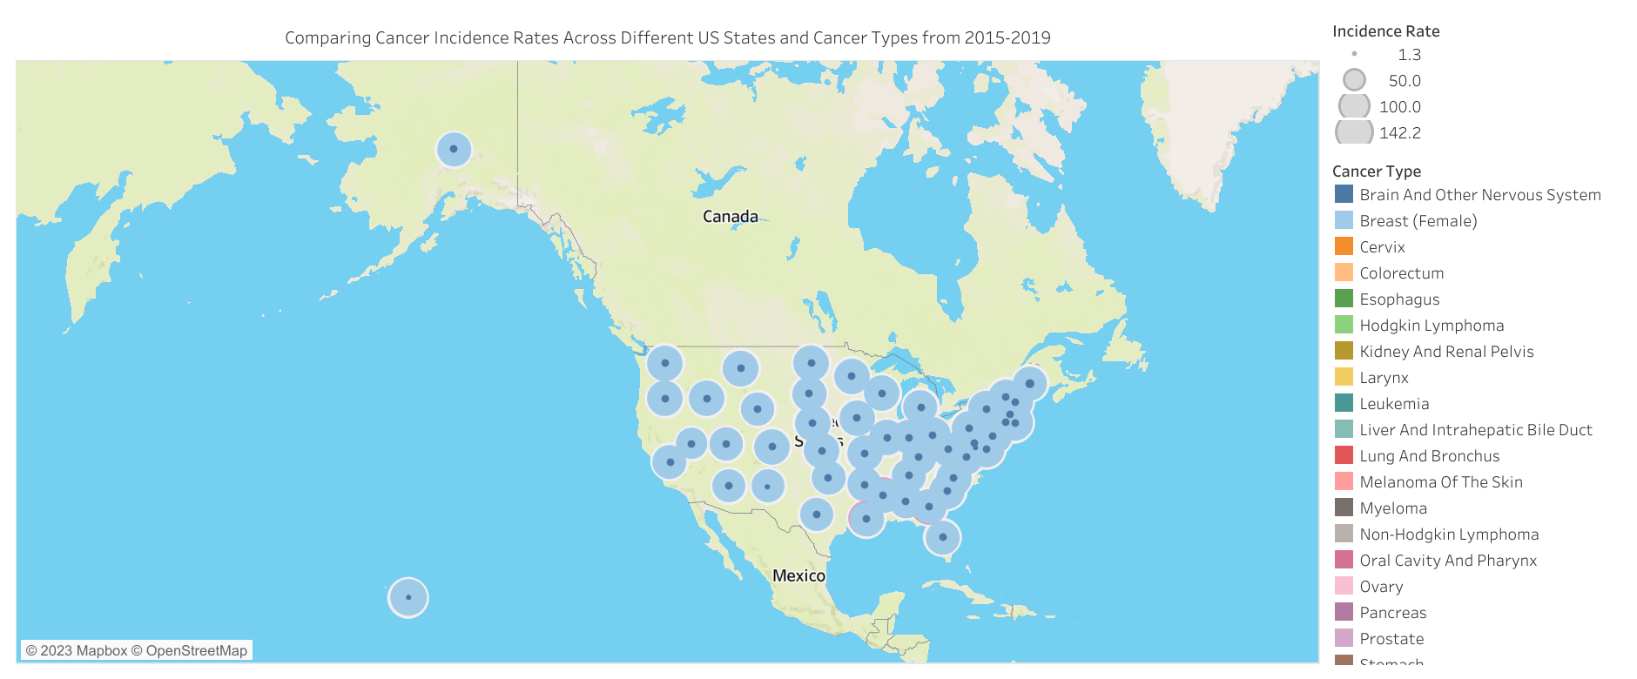

Slide 61
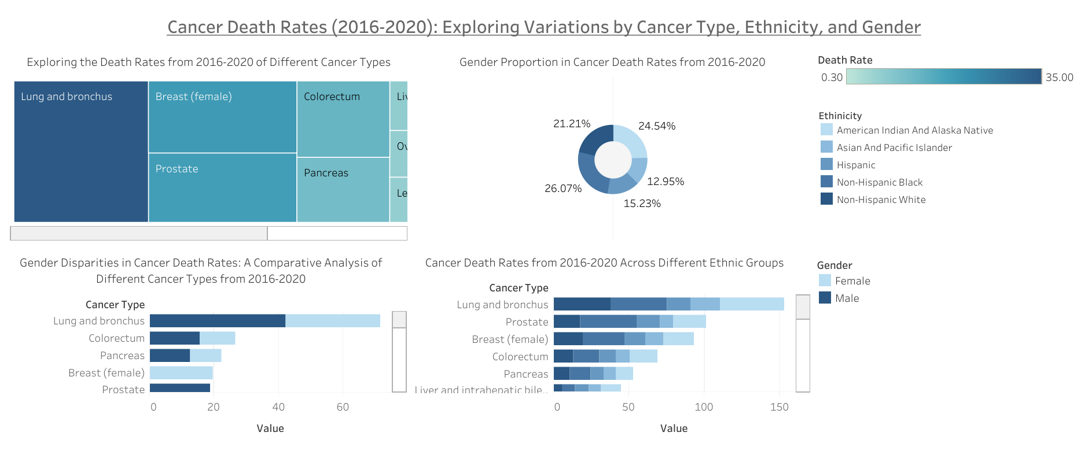

Slide 62
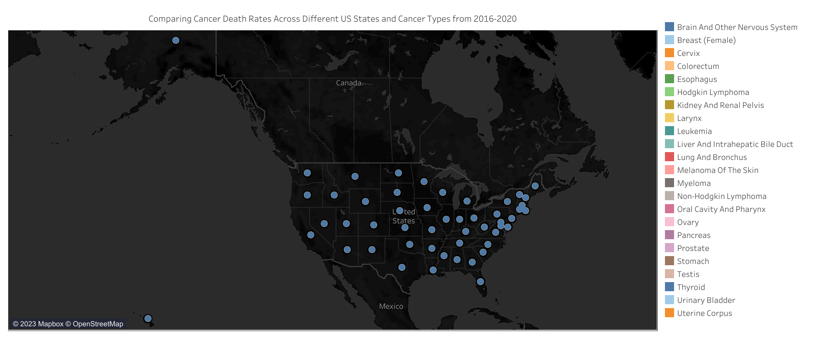

Slide 63
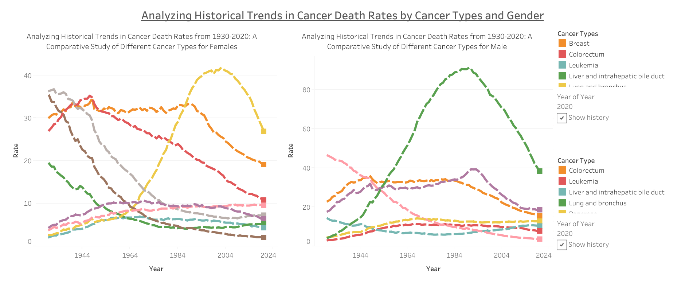

Slide 64
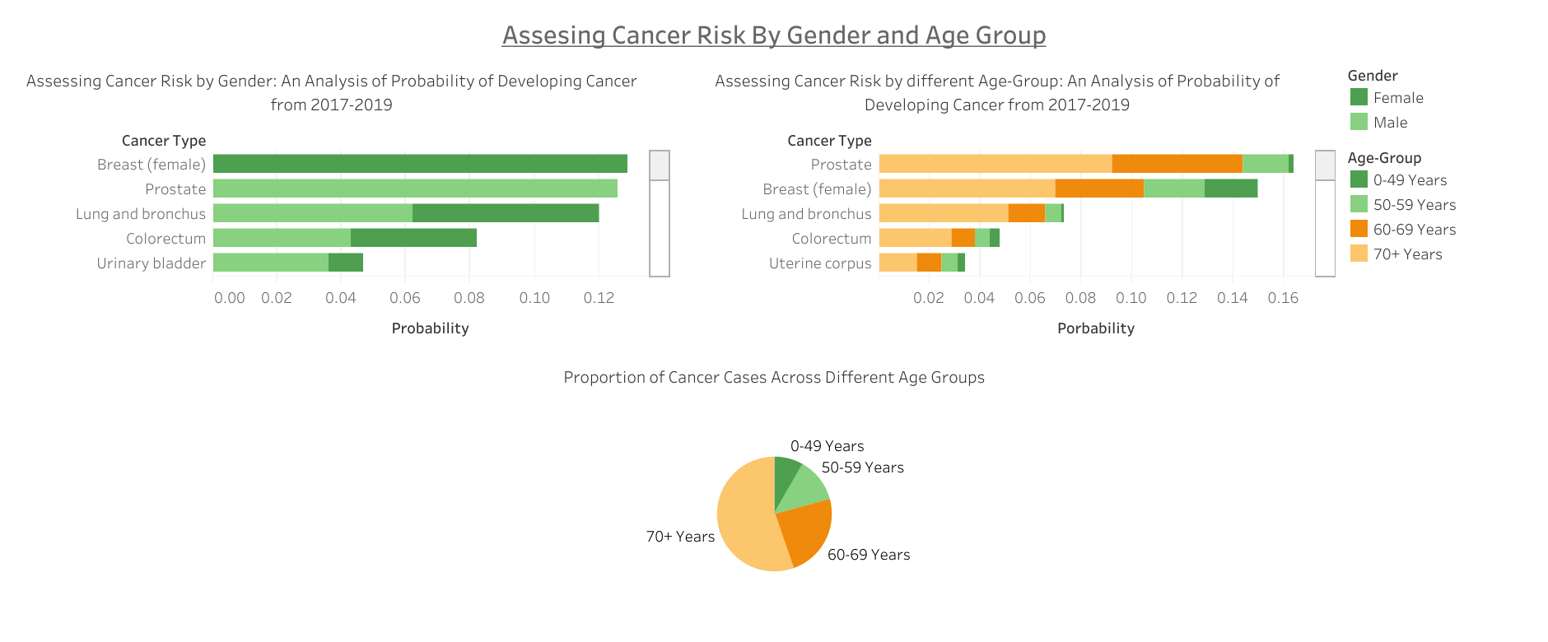

Slide 65
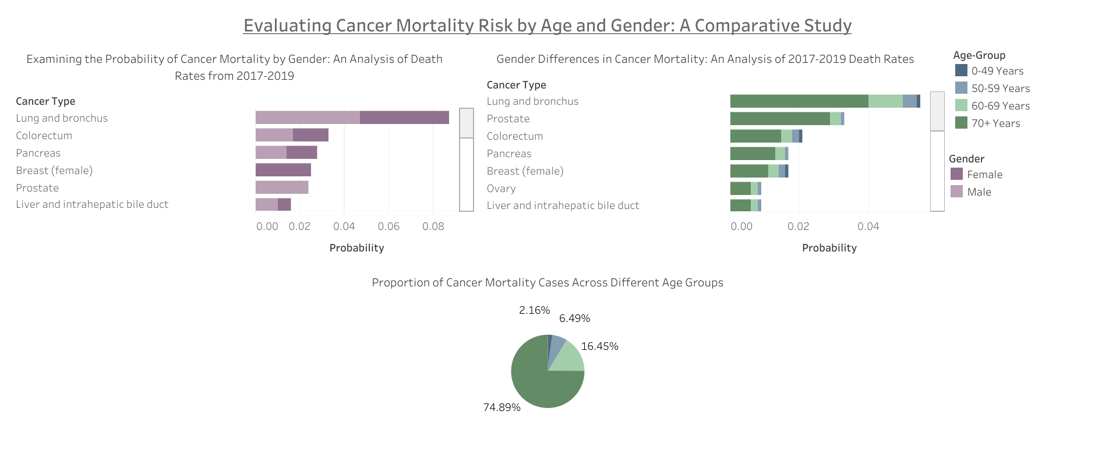

Slide 66
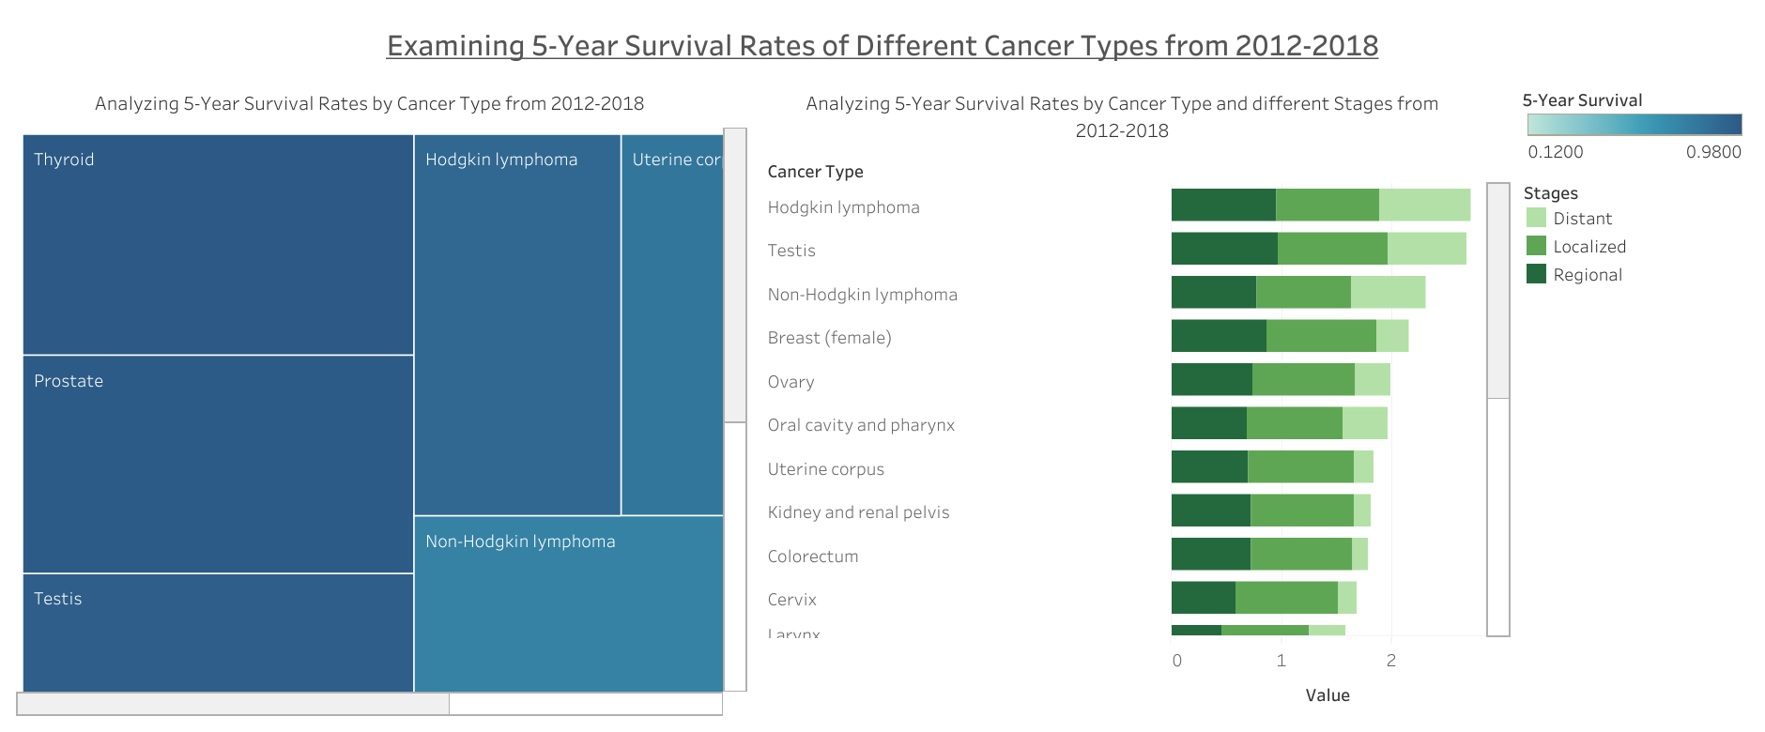

Slide 67

Conclusion

Slide 68
Conclusion
The dashboards discussed provide valuable insights into cancer cases, procedures, and healthcare facilities in California, allowing healthcare practitioners and the general public to better understand the distribution of cancer treatments and costs.
The information presented in these dashboards is helpful for healthcare organizations, pharmaceutical firms, and insurance companies to create preventative, treatment, and coverage plans, and to identify regions with high cancer incidence or mortality rates.
The data can be used to develop targeted interventions to address the issue of breast cancer in California and to lower the fatality rate and enhance patient outcomes.
Businesses in the healthcare industry may find it helpful to use the data from these assessments to better understand how COVID-19 has affected patient behavior and employee attrition.
The employment-related insights might assist firms in better understanding the labor market and making knowledgeable hiring and staffing decisions.

Slide 69
Conclusion
The data provided in the dashboards can assist healthcare professionals and researchers in gaining a better understanding of the cancer treatment landscape and the various medications available for treating different types of cancer.
By providing a detailed breakdown of patient encounters across different health categories and settings, the dashboards offer a comprehensive understanding of healthcare demand in various regions.
The mortality trends analysis helps to identify leading causes of death and their distribution across different diagnosis types and settings, ultimately benefiting both patients and healthcare providers.
The information obtained from these dashboards can eventually lead to improved healthcare outcomes for cancer patients and communities.
Overall, the dashboards offer a wealth of information for healthcare professionals and business stakeholders to monitor and analyze hospital utilization and in-hospital mortality trends, and to optimize healthcare operations and improve patient outcomes.

Slide 70

Tableau Dashboard Links
An Analysis of California Hospitals: Cancer Surgery Volume, Hospital Characteristics, and Patients Leaving Against Medical Advice (AMA) in Fiscal Year 2019-20
Life-Saving Cancer Treatments: A Comprehensive Guide to Approved Medications
Understanding the Financial Burden of Cancer Care on Patients and Families
Effects of COVID-19 on Hospital Utilization Trends: Hospital Utilization Trends
Geographic Analysis of Advanced Stage Breast Cancer in Women 40 Years and Older: A Study of Medical Service Study Areas and California Counties from 2010-2014
Assessing the Impact of COVID-19 on General Population Health Services: Results from a 2020 Survey
The Global Burden of Cancer: Understanding the Impact on Health and Society
Mapping the Burden of Cancer: A State-by-State Analysis of Cancer Incidence and Mortality in the US

Slide 71
References
https://ghdx.healthdata.org
https://data.chhs.ca.gov
https://hints.cancer.gov
https://data.cdc.gov
https://www.anticancerfund.org/
https://seer.cancer.gov/
https://cancerstatisticscenter.cancer.org/
https://progressreport.cancer.gov/
https://cdphdata.maps.arcgis.com/apps/webappviewer/index.html?id=8612fd4394784bdea7b0bdca5e34fc2e
https://www.tableau.com/

Slide 72


